Slide 1



Improving traffic efficiency with adaptive traffic signal control
The InSync experience on 10th Street
(US 34 Business) in Greeley, Colorado.
Notes:
Atkins in lower left corner (white)

Slide 2
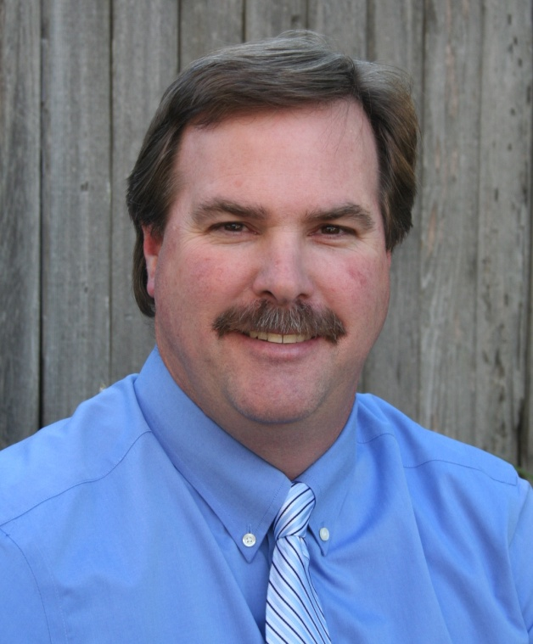

About the project team
Larry Haas, PE
  CDOT Region 4 - Traffic Operations Engineer
  24 years with CDOT
Contact information
  Email: Larry.Haas@state.co.us
  Phone: 970-350-2143
Eric L. Bracke PE, PTOE
  City of Greeley- Traffic Engineer
  35 years of traffic engineering/transportation planning experience
Contact information
  Email: Eric.Bracke@greeleygov.com
  Phone: 970-350-9357

Slide 3
Outline
Project development
Project implementation
Project evaluation
Next steps
But first ……

Slide 4
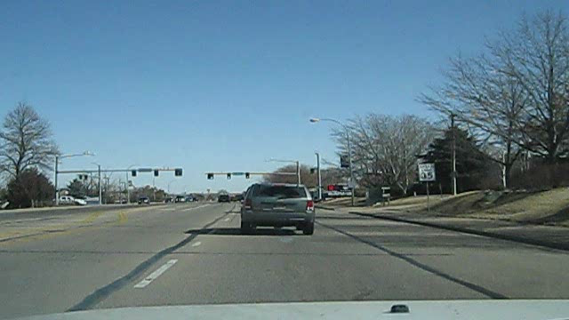
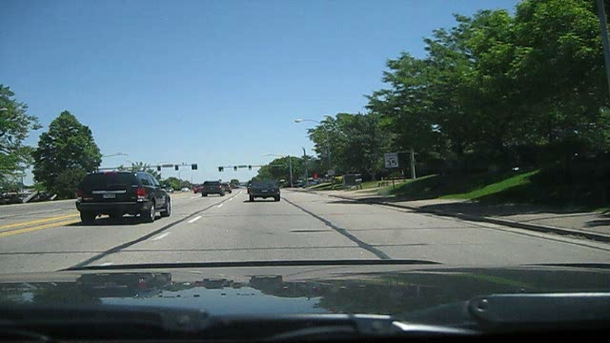
Adaptive signal timing is providing immediate benefits to customers
Better driving experience
Before (Eastbound)
Time Period: Noon to 1 pm
59th Avenue to 23rd Avenue
Average speed: 30 mph
Average stopped time: 57 sec
Average number of stops: 2+
After (Eastbound)
Time Period: Noon to 1 pm
59th Avenue to 23rd Avenue
Average speed 34 mph
Average stopped time: 29 sec
Average number of stops: 1
Notes:
Same stretch of highway for a typical weekday (Wednesday for both of these)
Full Travel run from end to end – this is middle section near typical congested areas
Videos are same length of time

Slide 5
Adaptive signal timing is providing immediate benefits to customers
Shorter travel time/less delay
Travel Time Benefits
Time Period | Total Trip Time Saved (%) | Time Saved (sec/veh/trip) | Daily Time Saved (hours) | Daily Savings | Annual Savings (millions)
Weekdays | 9 | 32 | 218 | $4,251 | $1.06
Weekends | 11 | 40 | 179 | $3,491 | $0.35
Yearly |  |  | 72,400 | $4,034 | $1.41
Notes:
Weekday benefit assumes 250 typical weekdays in a year
Weekend assumes 100 typical weekend days in a year
Value of time was $15.00 per person (FHWA and DTD)
Average occupancy per vehicle was 1.3 (DTD)
Hourly cost per vehicle is $19.50 ($15.00 * 1.3 = $19.50)
Daily Savings for the year means $4,034 per day

Slide 6
Adaptive signal timing is providing immediate benefits to customers
Fewer stops on 10th Street
Reduction in Stops
Time Period | Total Stops Eliminated (%) | Number of Fewer Stops
Weekdays | 37 | 16,477
Weekends | 52 | 16,941
Year |  | 5,813,350
1 out of 3 stops eliminated on weekdays
1 out of 2 stops eliminated on weekends
Notes:
Weekday #s are based on the hours of 6 am to 9 pm
Weekend #s are based on the hours of 10 am to 8 pm on a Saturday
Weekday benefit assumes 250 typical weekdays in a year
Weekend assumes 100 typical weekend days in a year

Slide 7
Adaptive signal timing is providing immediate benefits to customers
Higher travel speeds
11%, or 3 mph per vehicle, on weekdays
13%, or 4 mph per vehicle, on weekends
Notes:
All time periods except EB AM show equal or improved after travel speeds
AM progression is set to favor westbound traffic toward I-25 (9 mph improvement for these vehicles)

Slide 8
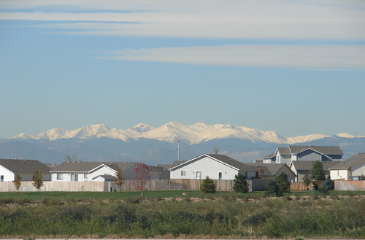
Adaptive signal timing is providing immediate benefits to customers
Better air quality with lower vehicle emissions
Vehicle Emissions Reduction (pounds)
Time Period | Pollutant
 | Carbon Monoxide | Hydro-Carbons | Nitrogen Oxides
Weekdays | 28 | 2 | 6
Weekends | 19 | 1 | 5
Year | 8,900 | 600 | 2,000
Notes:
Weekday benefit assumes 250 typical weekdays in a year
Weekend assumes 100 typical weekend days in a year

Slide 9
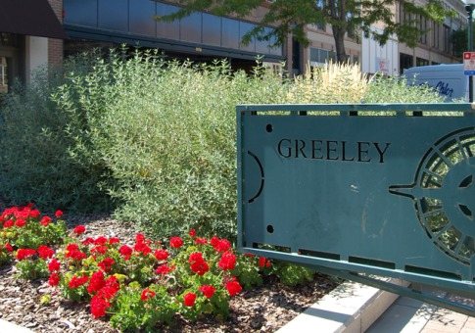
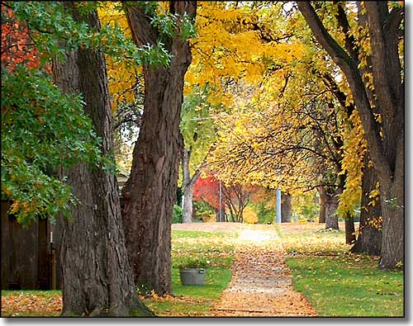
Adaptive signal timing is providing immediate benefits to customers
A greener environment
Green House Gas Reduction (pounds)
Time Period | Carbon Dioxide
Weekdays | 2,656
Weekends | 2,159
Year | 888,536
Notes:
Weekday benefit assumes 250 typical weekdays in a year
Weekend assumes 100 typical weekend days in a year

Slide 10
Adaptive signal timing is providing immediate benefits to customers
Reduced fuel consumption
Fuel Consumption Reduction
Time Period | Total Fuel Consumption Reduction (%) | Gallons Saved (gal/day) | Daily Savings | Annual Savings
Weekdays | 3 | 129 | $470 | $117,700
Weekends | 4 | 104 | $380 | $38,000
Year |  | 54,900 | $572 | $155,700
Notes:
Weekday benefit assumes 250 typical weekdays in a year
Weekend assumes 100 typical weekend days in a year
Gallon of gas price $3.65 (research or local gas prices at time of project)

Slide 11
Project development
Project implementation
Project evaluation
Next steps

Slide 12
Project development
CDOT’s mission is:
  “to provide the best multi-modal transportation system for Colorado that safely and most efficiently moves people, goods, and information.”
Region 4 Traffic unit identified current approach to signal timing as an obstacle
  Budget limitations
  Focus on weekday peak periods
  Signal timing plans in controllers are outdated
Notes:
Budget: Can only retime every 5+ years
Peak periods: What about the other 18+ hours of the day and weekends
Outdated timing: Results in increase to delay, fuel consumption, vehicle emissions, crashes, driver frustration, and congestion

Slide 13
Project development
CDOT’s criteria for improving traffic signal timing
  Provide benefits for the traveling public
  Ensure signal timing is up to date
  Improve signal timing 24/7
  Maximize the existing capacity of a corridor
  Expand staff knowledge/expertise
  Minimize required staff time to maintain
Notes:
Public Benefits: Reduced delay, lower fuel consumption, minimize vehicle emissions, fewer crashes, decrease driver frustration, and improve congestion
Updated timings: System adapts to current traffic volumes in real time
24/7 timing: Eliminates applying peak period timing plan to off peak time and addresses weekend traffic patterns automatically
Capacity: get the most out of what is there – delay the need to build new or add capacity
Staff knowledge: Allow staff to gain experience with new state of the art technology – be a leader in the industry
Staff hours: Staffing levels not increasing, but level of responsibility continues to increase. Trying to do more with less or the same.

Slide 14
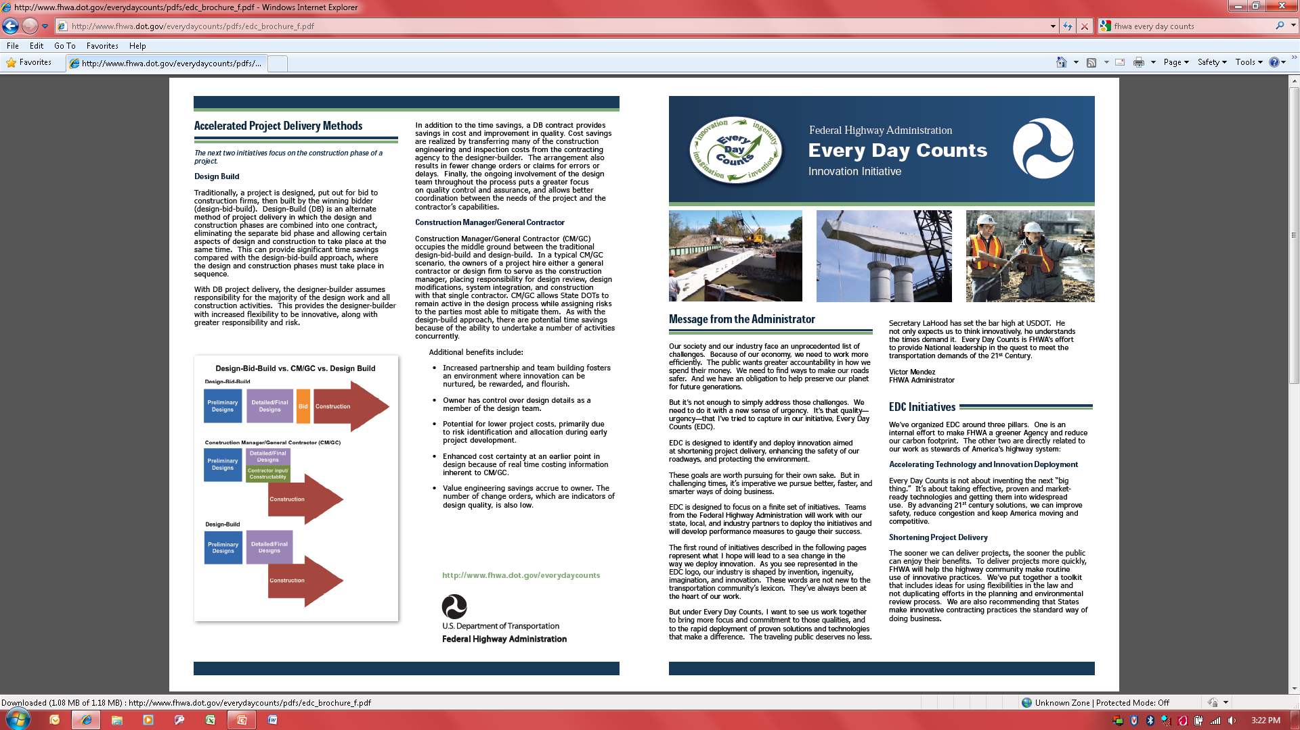
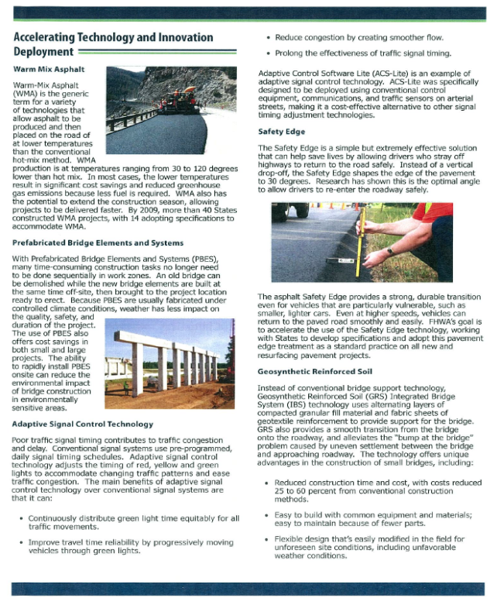
Project development
FHWA’s Every Day Counts (EDC) Innovative Initiative goals
  Implementation of existing technology and innovation
  Improve safety, reduce congestion, and keep America moving
  Stop building and maximize the existing transportation system

Slide 15
Project development
Adaptive traffic signal control
  Provides benefits for the traveling public
  Ensures signal timing is up to date
  Improves signal timing 24/7
  Maximizes the existing capacity of a corridor
  Expands staff knowledge/expertise
  Minimizes required staff time to maintain
  Achieves FHWA’s EDC goals
Result
  CDOT elected to improve signal timing by implementing adaptive traffic signal control technology
Notes:
Technology has been shown to provide benefit to traveling public
Timing plans are based on current traffic conditions
Provides 24/7 signal timing – not just peaks
Maximizes the existing transportation system by improving throughput and delaying need for capacity improvement
Exposes staff to new technology
Once system is operating, minimum staff time required to maintain
Adaptive control is specifically listed as a solution to poor signal timing in FHWA’s EDC program

Slide 16
Project development
Early actions to ensure project success
  Identified and secured additional funds
  NFRMPO
  CDOT R4 signal funds
  Entered partnership with a local agency to share short/long term roles/responsibilities
  Greeley willing to maintain/operate
  Perform future Air Quality measurements
  Engaged CDOT HQ Research Branch
  Supportive of new technology
  Will perform long term safety evaluation
Notes:
Funding
CDOT had funds available
NFRMPO had CMAQ
City of Greeley could supplement
Partnership
CDOT
purchase/install system and initial evaluation
City of Greeley
Maintain and operate system after installation
Perform air quality measurement in future
Collaboration
CDOG HQ interested in experimental technology and will perform long term safety review

Slide 17

Project development
Early actions to ensure project success
  Satisfy FHWA requirements
  Finding in the public interest (FIPI) completed
  Systems Engineering Analysis (SEA) completed
  FHWA has new SEA process for the selection of adaptive signal control technology
http://ops.fhwa.dot.gov/publications/fhwahop11027/mse_asct.pdf
Notes:
Collaboration
System engineering analysis and FIPI completed for FHWA

Slide 18
Project development
Corridor selection criteria
      CDOT facility
      Mix of urban/rural characteristics
      Already operating with time of day coordinated timing plans
      Heavily used by staff to allow for instant feedback
      Failure of implementation would have minimal regional impact
  Result
  10th Street (US 34 Business) between 23rd Avenue and 83rd Avenue
Notes:
CDOT facility – US 34 Business is a highway
Mix of urban/rural characteristics – urban near east end and rural at west end – Speed limits from 35 to 65 mph
Already operating with time of day coordinated timing plans – timing plans done in 2005 and still working well
Heavily used by staff to allow for instant feedback – many city and state employees drive the corridor daily
Failure of implementation would have minimal regional impact – not a major volume corridor, could revert to time of day plans

Slide 19
Project development
Some unique characteristics of the corridor
  Two intersections operating with a single controller (23rd Avenue)
  Shared thru-left lane assignments leading to split phasing requirements (worked with City to keep existing phasing)
  Corridor has multiple speed zones
  Large trip attractor in middle of corridor results in irregular side street demand
Notes:
Speeds of 35 to 65 mph
Wal-Mart is large trip attractor

Slide 20
Project development
CDOT investigated common adaptive signal systems
  Split Cycle Offset Optimization Technique (SCOOT)
  Sydney Coordinated Adaptive Traffic System (SCATS)
  Real Time Hierarchical Optimized Distributed Effective System (RHODES)
  Optimized Policies for Adaptive Control (OPAC)
  Adaptive Control Software Lite (ACS-Lite)
  QuicTrac (by McCain)
  InSync (by Rhythm Engineering)
Notes:
Due to success of adaptive technology this industry is growing rapidly with more systems coming out
Thus the need to perform SEA analysis before implementing a new system.

Slide 21
Project development
System selection criteria
      Easy to install
      Requires minimal maintenance
      Fully compatible with the existing traffic signal system
      Capable of relying on historic data
      Compatible with planned fiber optic system
      Easy to revert to old timing plans
      Proven track record of improving traffic operations
  Result
  Selected the InSync system
Notes:
System must be easy to install and require minimal maintenance efforts once in operation
InSync suppose to be “plug and play” by simply connecting an additional processor unit to the existing controller
System reduces staff time
No need for large retiming projects, maintenance efforts reduced to keeping system running (replace bulbs, clean cameras, aim cameras) and checking in on from time to time
System must be fully compatible with the existing traffic signal equipment, software, and operation system
InSync was fully compatible with all elements of the existing signal system
System can rely on historic data
Capable of relying on historic data in case of power outages, weather events, or loss of communication
System compatible with future City of Greeley fiber optic communication system
InSync would fully integrate with the fiber optic system
System can be bypassed
Easy to revert to old timing plans (simply hit a turn off switch)
System must have a proven track record of improving traffic operations
Successful installs of InSync included: Columbia (Missouri), Springdale (Arkansas), Evans (Georgia), Lee’s Summit (Missouri). San Ramon (California)
Subsequent success have occurred

Slide 22
Project development
Project implementation
Project evaluation
Next steps

Slide 23
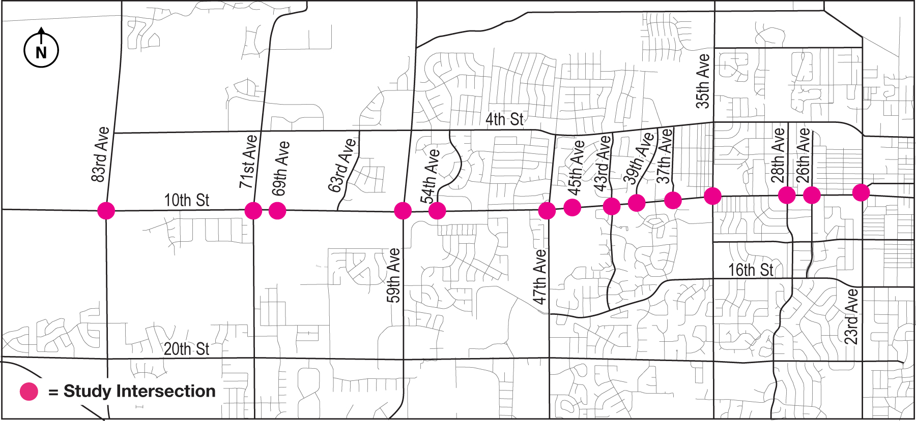
Project implementation
Original limits included 14 intersections

Slide 24
Project implementation
InSync a plug and play system?
  System processor plugs into existing controller and ready to go
Actual project needs included (extra costs)
  Digital video detection
  Pedestrian module
  Communication system between all intersections*
  Repeaters
  Amplifiers
  Larger controller cabinets*
  Communication system to reach City TOC*
  * Cost could be saved on corridors that already have these items in place
Notes:
Initial thought was only needed to plug the new processor into the controller and turn on system
Communication system for this project was a wireless broadband approach
Communication back to the TOC included the need to first send signal to top of water tower then to TOC
Communication system to be replaced with City fiber optic in the future.
Pedestrian module separate from vehicle components
At time of project digital video detection was required. System now more flexible on detection types.

Slide 25
Project implementation
Resulted in a reduction to 11 intersections

Slide 26
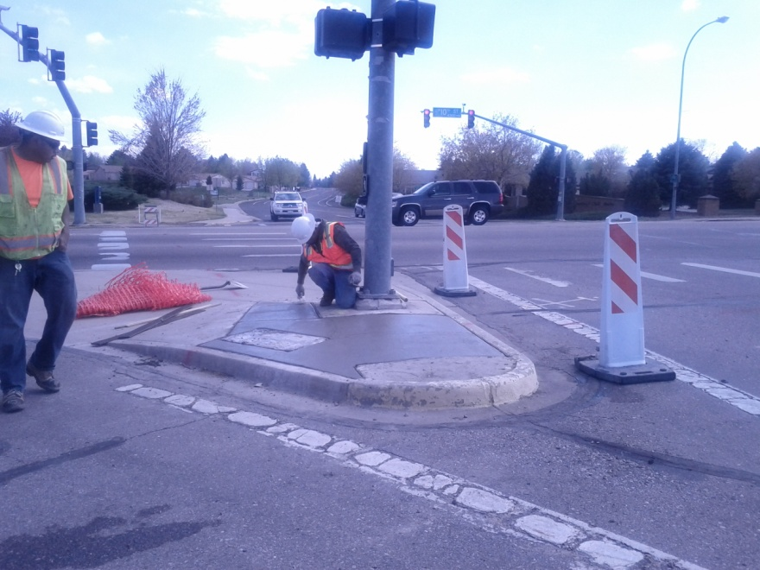
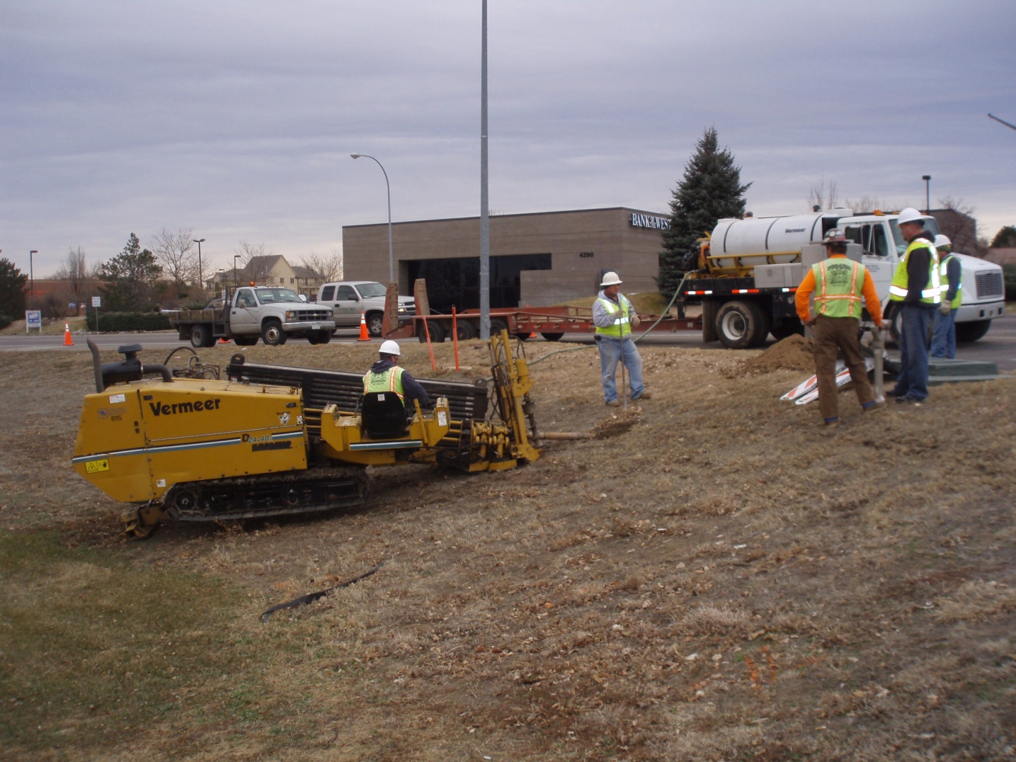
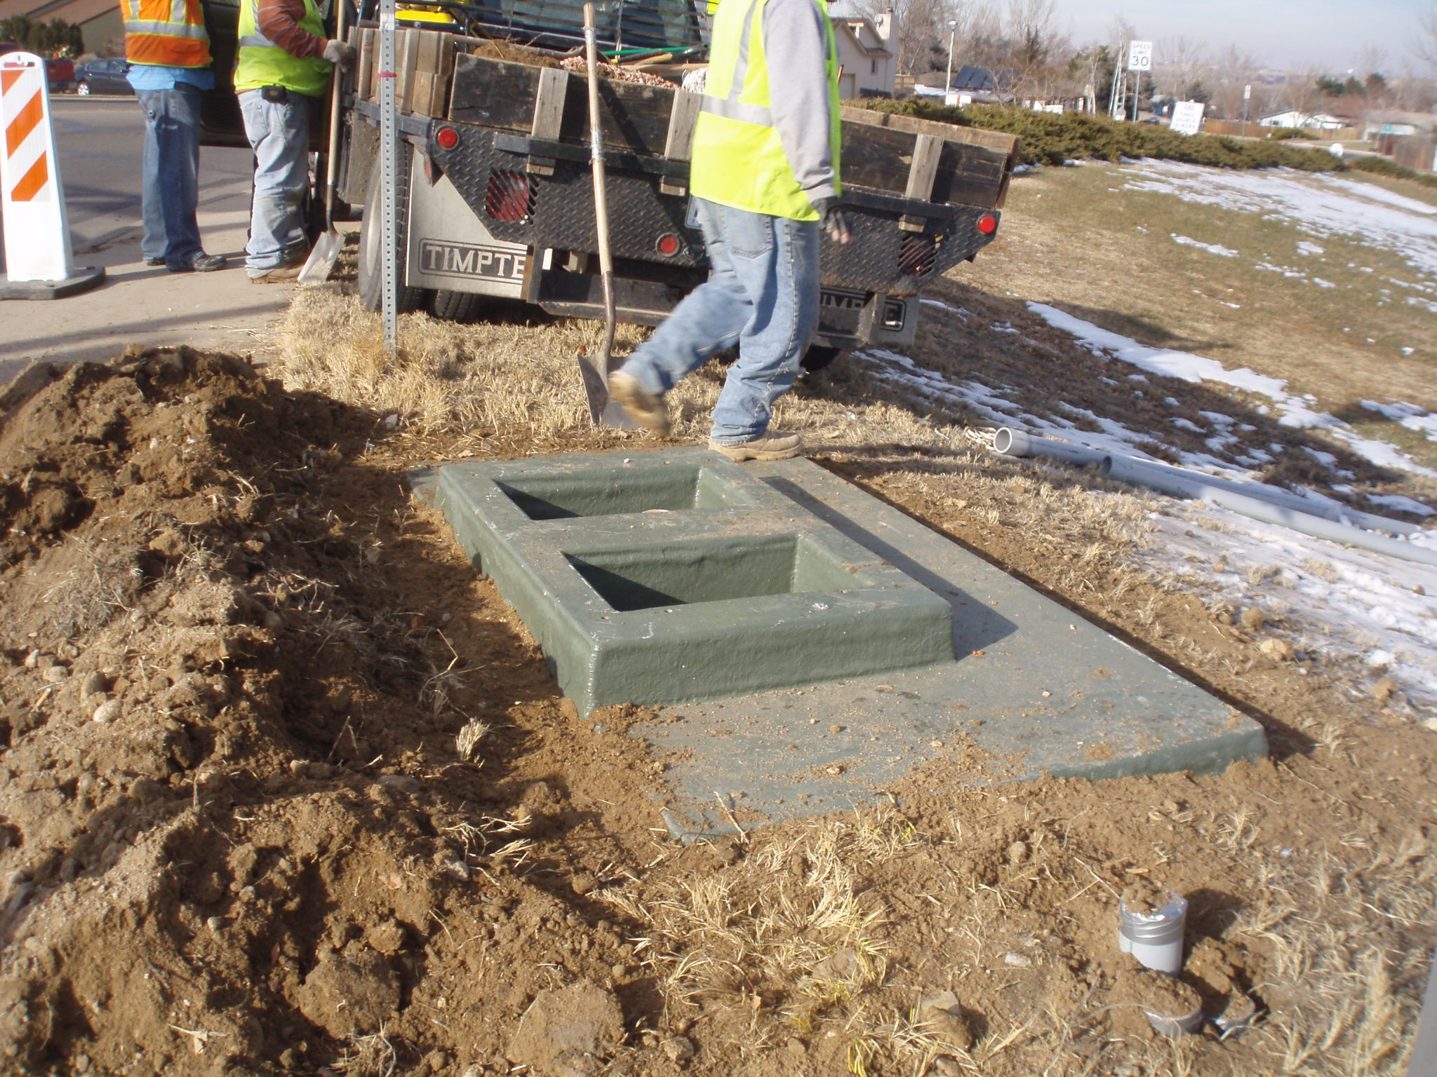
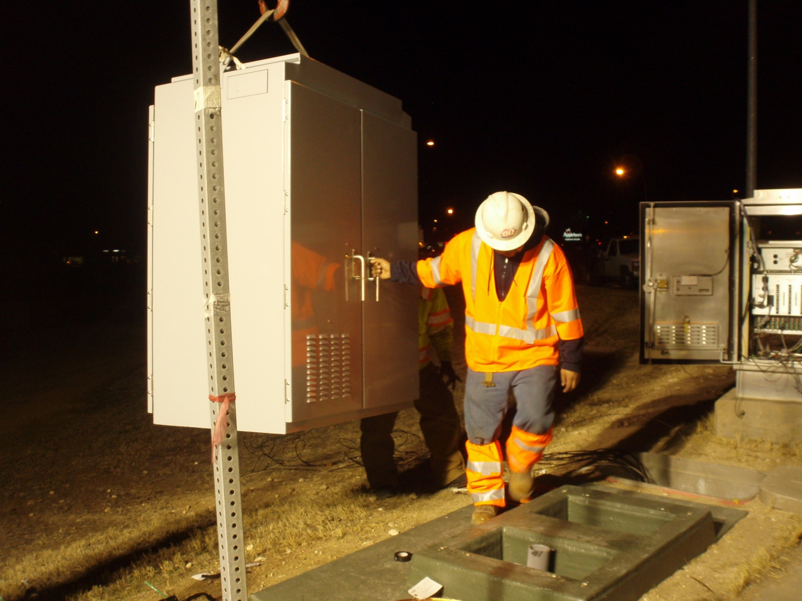
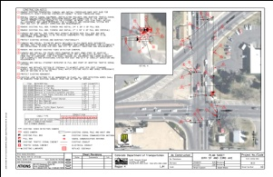
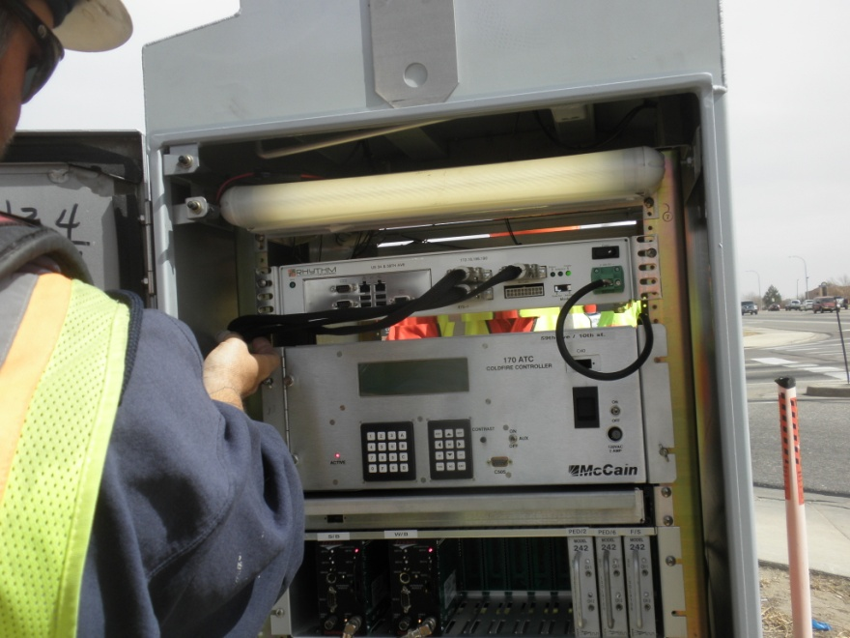
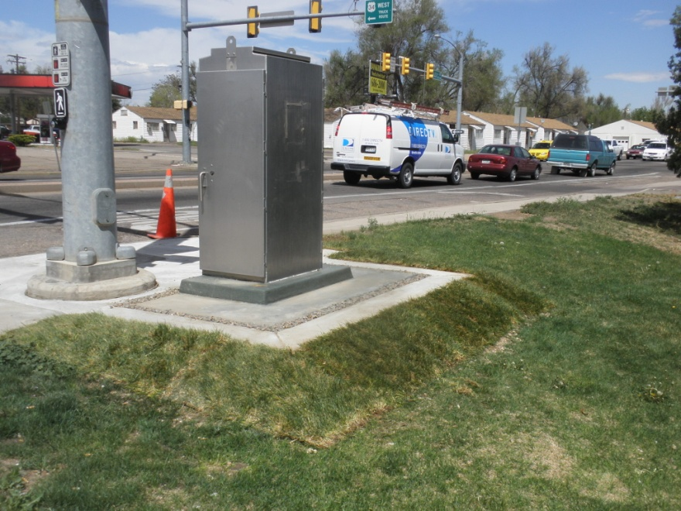
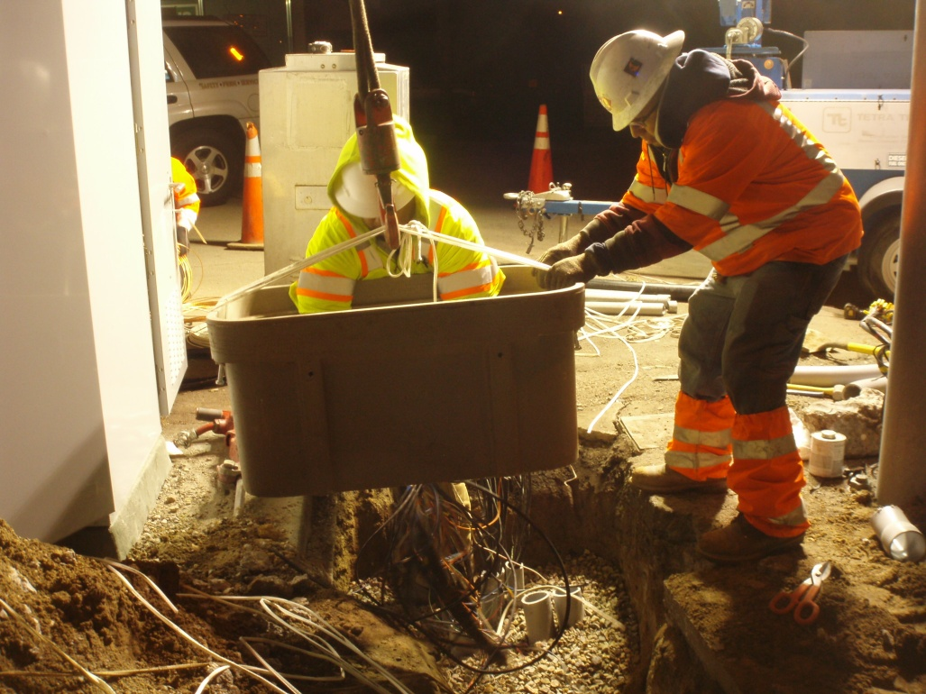
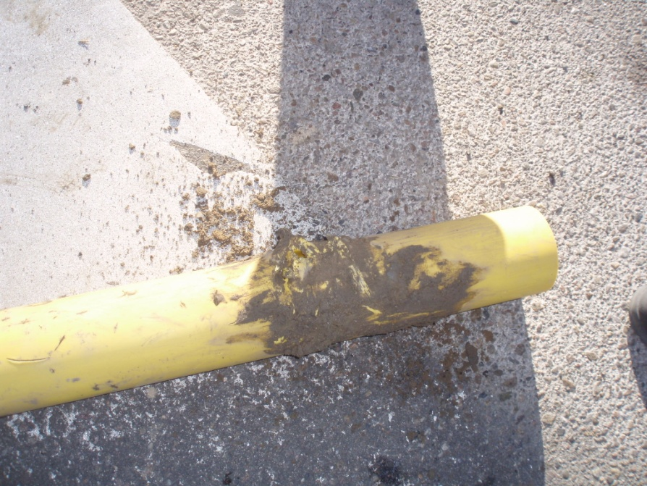
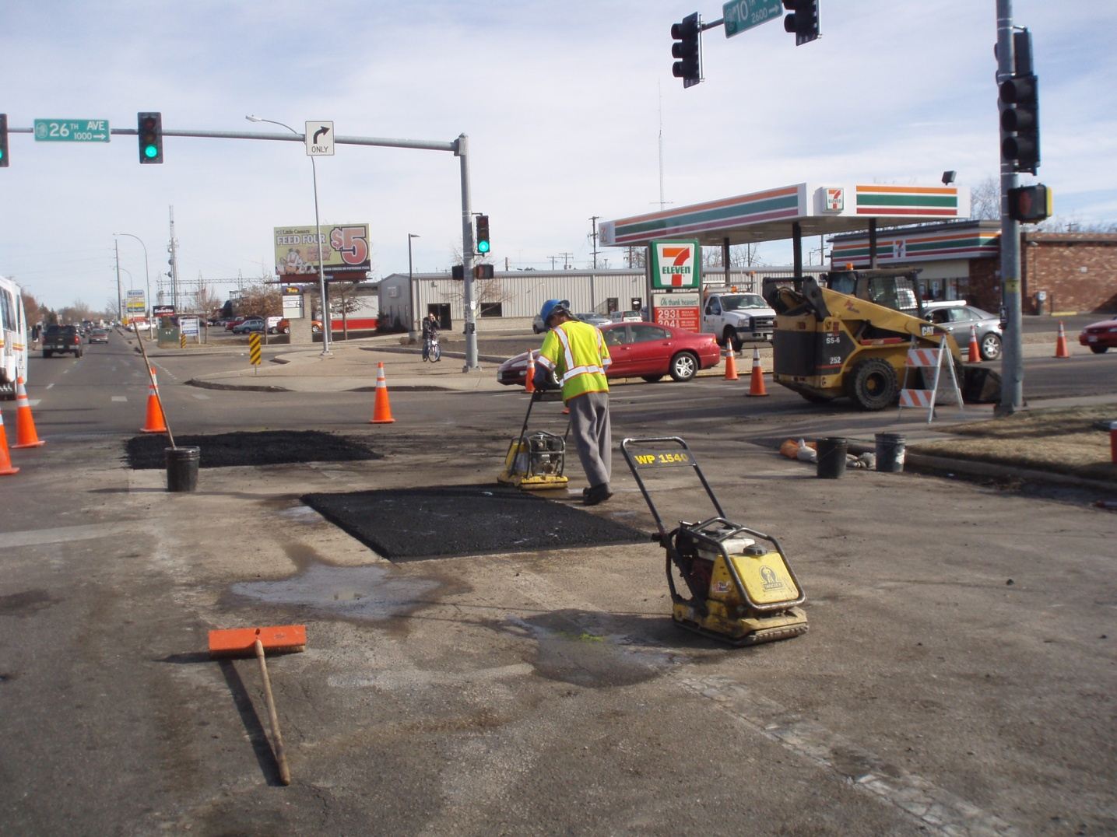
Project implementation
Design and construction experience
Go to next slide

Slide 27
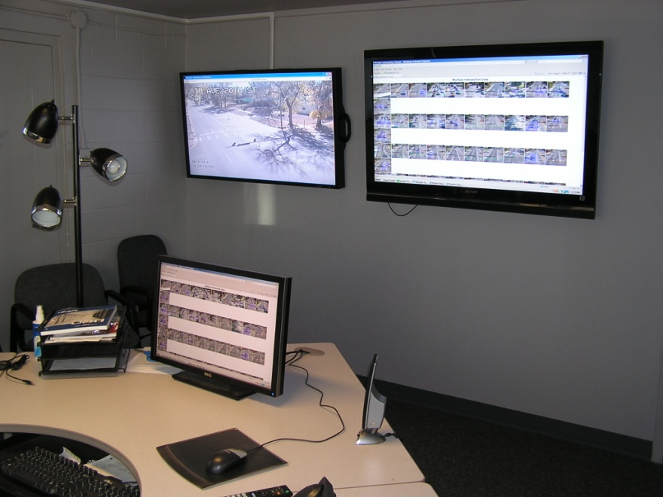
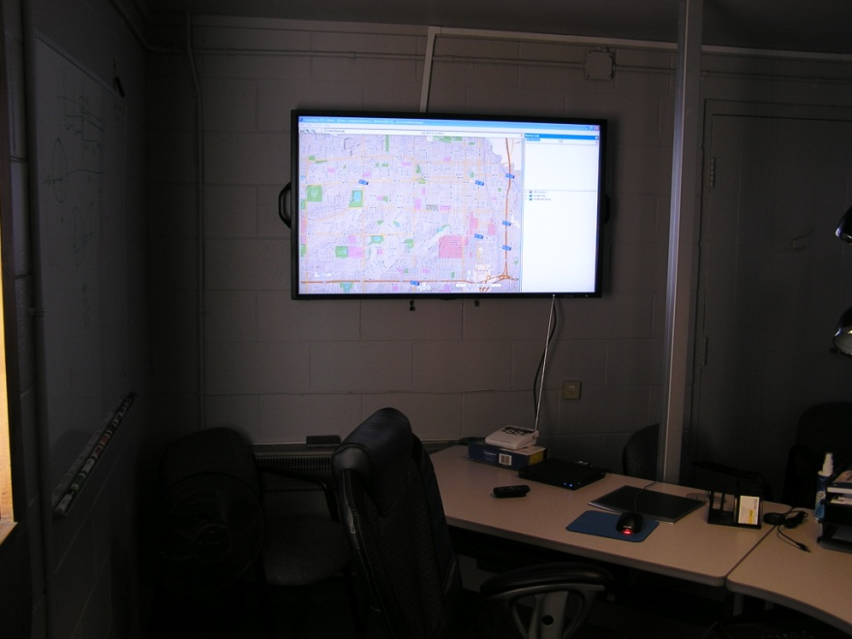
Project implementation
Early experiences with the system
  Initial side street delay issues
  System continues to adjust to traffic patterns
  System is developing historic databases
Notes:
Initial timing parameters in system resulted in side street delay issues
System parameters were adjusted
System adjusted to traffic conditions
Issue diminished

Slide 28
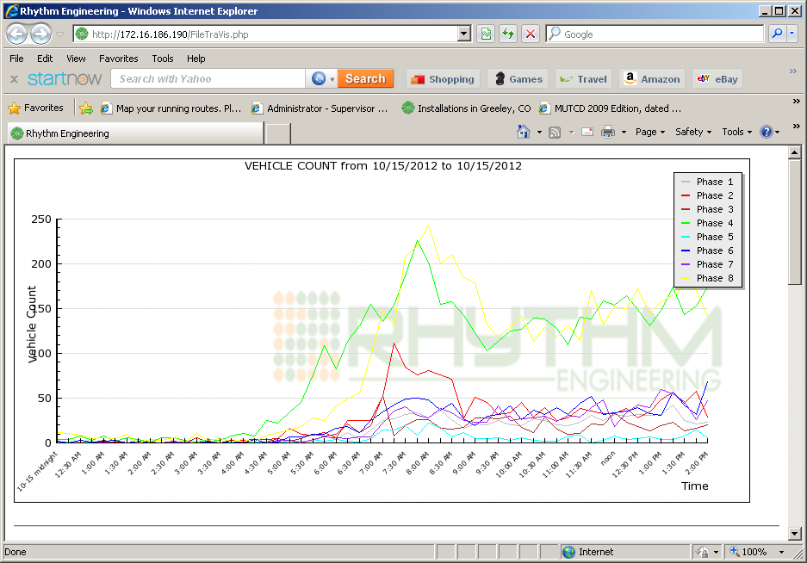
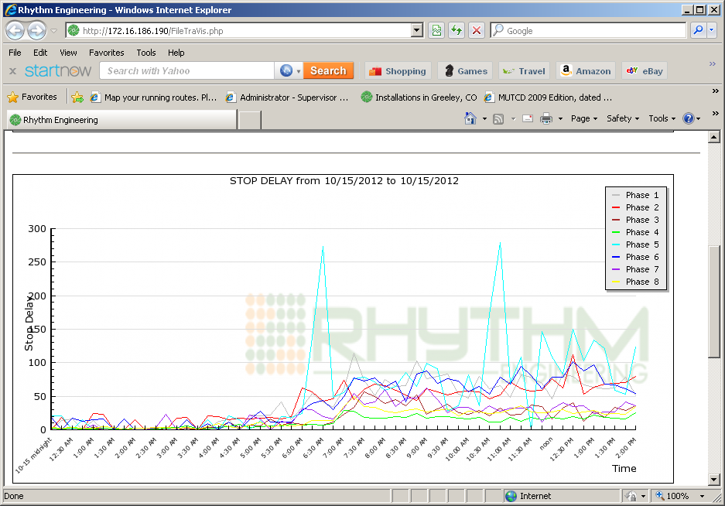
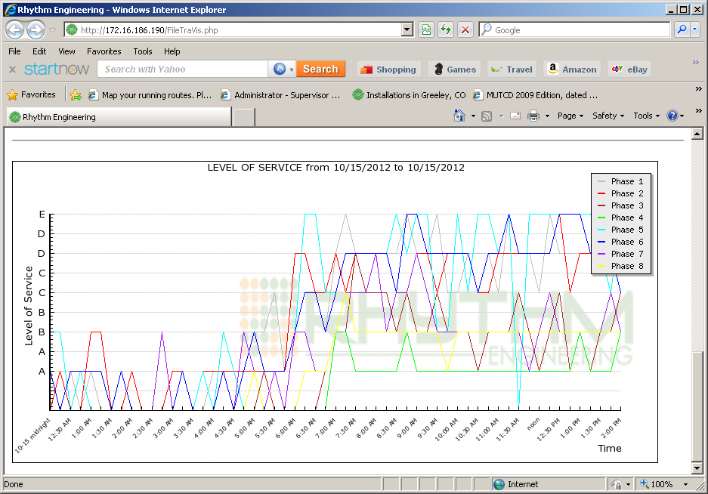
Project implementation
Staff still learning system capabilities
  For example: data collection/analysis tools
Vehicle counts
Stop delay
Level of service
Notes:
These are just a few examples of the system capabilities
Level of services is by phase and time of day.
LOS is not Highway Capacity definition, but an InSync propriatary calculation based on delay

Slide 29
Project development
Project implementation
Project evaluation
Next steps

Slide 30
Project evaluation
Cost to Implement |  | Computed Benefit
Category | Cost | Category | Benefit
InSync System | $416,000 | Maintenance | $41,000
Communication System | $45,000 | Fuel | $156,000
Engineering | $250,000 | Travel Time | $1,410,000
Construction | $194,000 | Side Street Delay | $282,000
Total | $905,000 | Total | $1,326,000
Overall First Year Benefit |  |  | $421,000
System pays for itself in less than 1 year
Notes:
Engineering includes both CDOT and consultant time
Side Street Delay shows that system does result in more wait time to side street traffic

Slide 31
Project evaluation
Estimated to save $9 million in 20 years
$9 million
Notes:
Assumes 2012 dollars

Slide 32
Project evaluation
The evaluation that really counts: the customer
  The Tribune, September 2012 – Cityguys get something right, really; by Mike Peters
    Based on positive comments from other citizens he completed his own travel times and noted few or no stops at all
  Unsolicited feedback from Brent Lahman a citizen that frequently travels10th Street
    “The timing improvements on 10th Street are excellent. The flow and the time it takes to go out 10th or back in on 10th are notably improved. Thanks for staying on that long-time project and making it happen. Please share my thanks and appreciation with your engineers and staff.”

Slide 33
Project development
Project implementation
Project evaluation
Next steps

Slide 34
Next steps
Continued on-call service by Rhythm
Re-evaluate in the future
Test systems memory capabilities
Evaluate crash data in future
Evaluate staff labor levels to maintain system
Monitor equipment life span
Transition to fiber optic communication (City of Greeley project)
Evaluate for possible implementation on other corridors
Notes:
Rhythm to provide upgrades to software and trouble shooting
Re evaluation in the future to include:
Travel times
Operations during weather/special events
Testing of memory could include
Turn off detector(s)
Power outage
Loss of communication
Safety evaluation to be done by HQ Research Branch staff

Slide 35
Thank you for your time
Questions

Slide 36
System overview
Processors collect real time traffic data
Processors implement optimized timing plan
Processors optimize corridor progression (offsets and cycle)
Processors optimize phasing schemes to satisfy corridor progression (splits)
Processors optimize phases at individual intersections (phasing scheme)

Slide 37
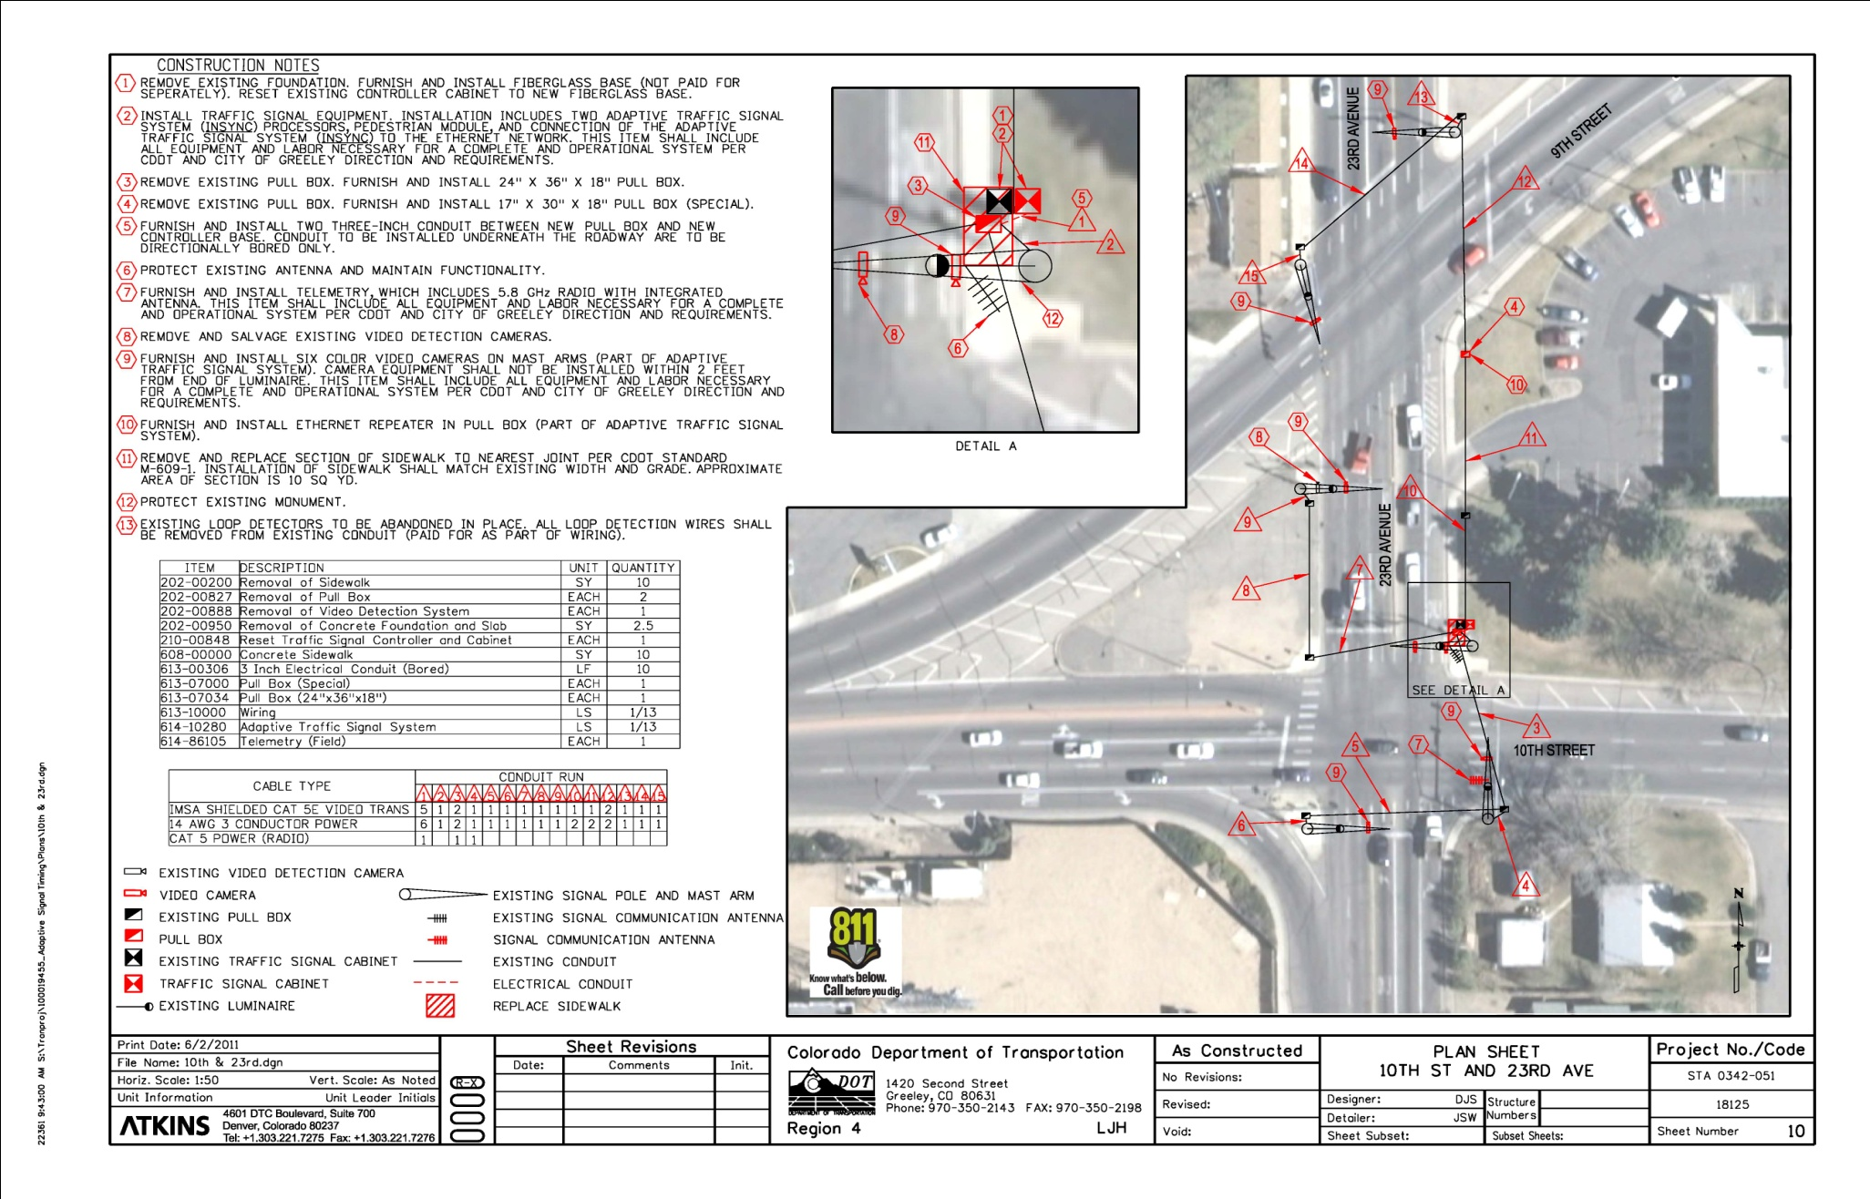
Go Back
Plans
Notes:
No ground survey
City GPS for right-of-way and utilities
Relied on field visual inspection of available conduit and condition

Slide 38
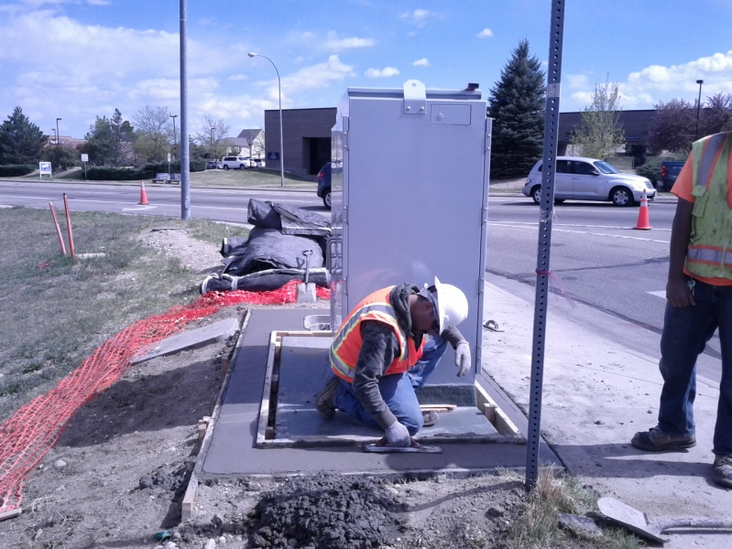
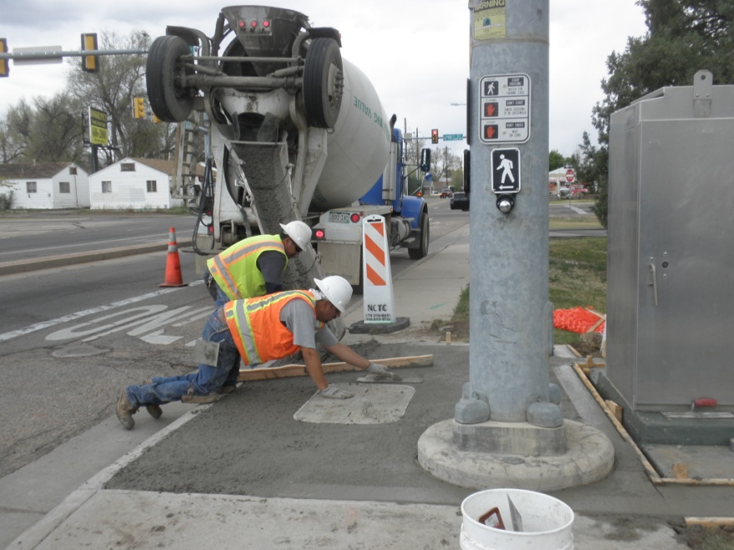
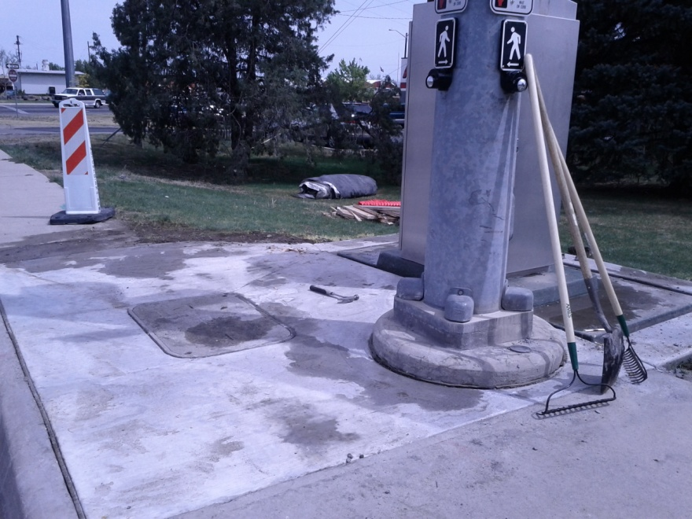
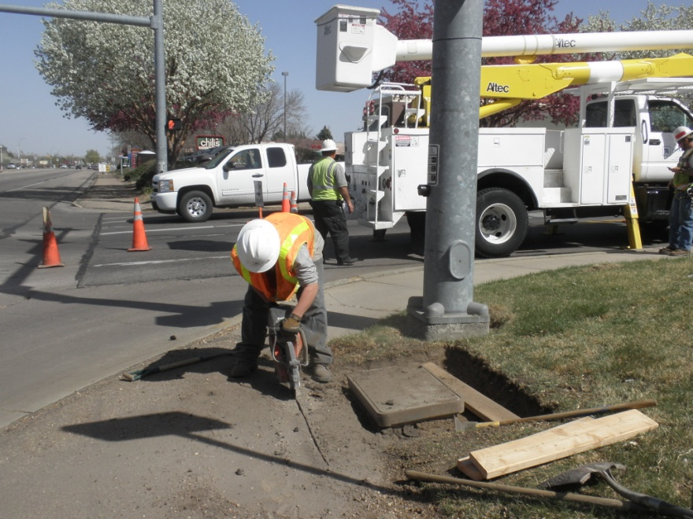
Go Back
Concrete work
Notes:
Project decided to fix current deficiencies or damaged sidewalks as part of the project
In some situations this included concrete around cabinets or upgraded pull boxes.

Slide 39
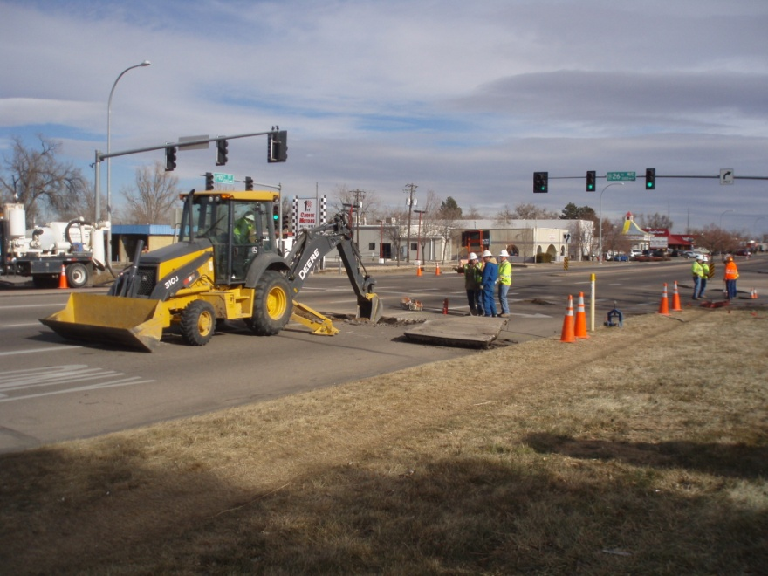
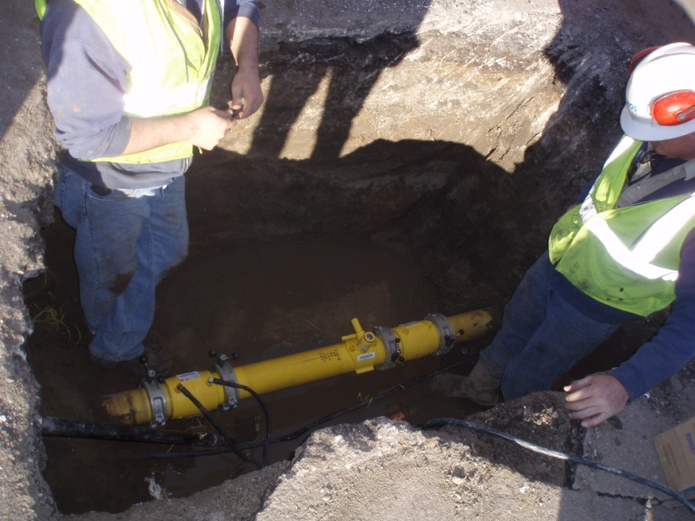
Go Back
Gas line
Notes:
Unexpected construction incident
Struck gas line

Slide 40
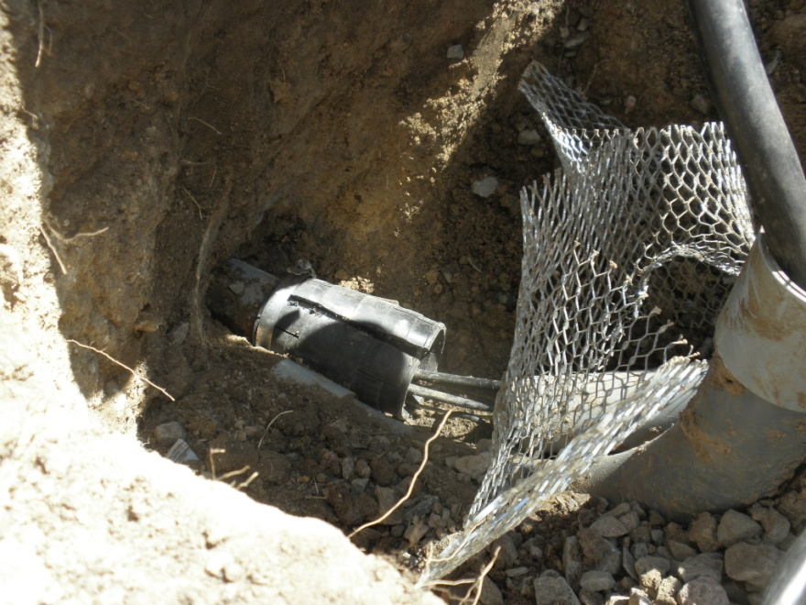
Go Back
Boring new/fixing old conduit
Notes:
Many existing conduits were inadequate for the needs of the system
Needed to bore new ones
Project found and fixed broken existing conduit lines

Slide 41
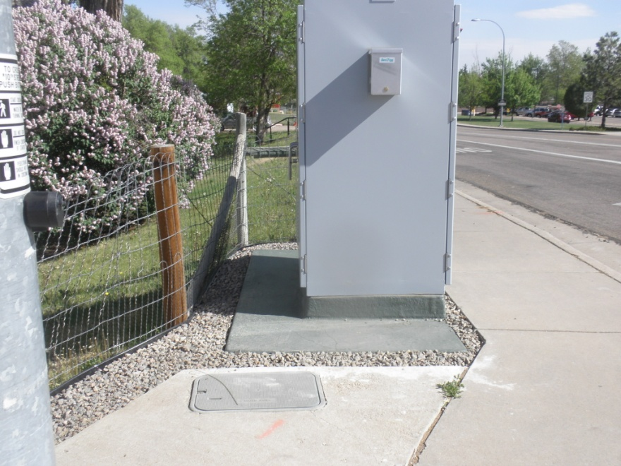
Go Back
Restore natural looks
Notes:
Project had to include landscaping to restore the areas to a natural look

Slide 42
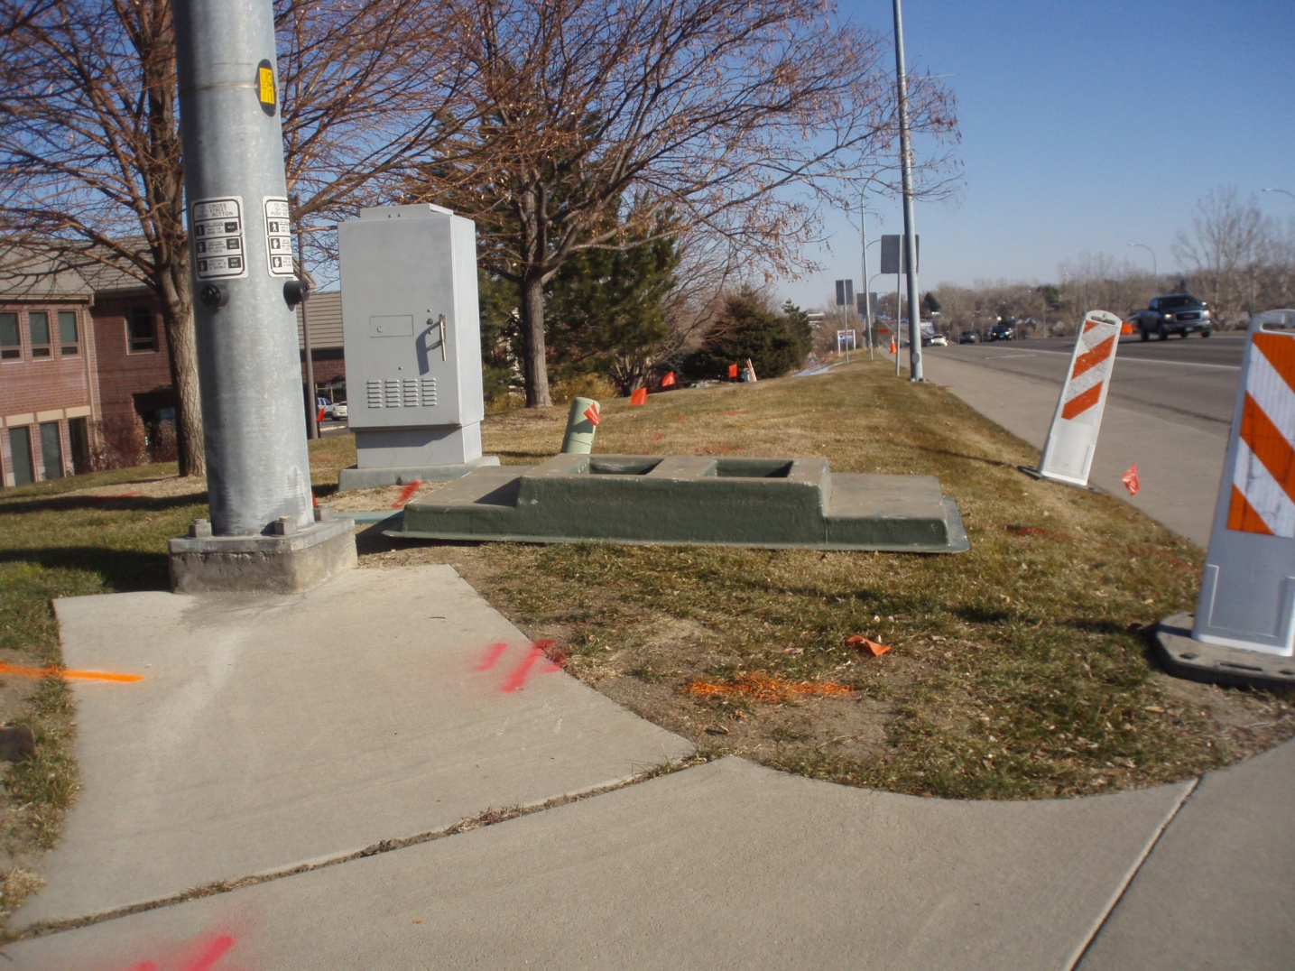
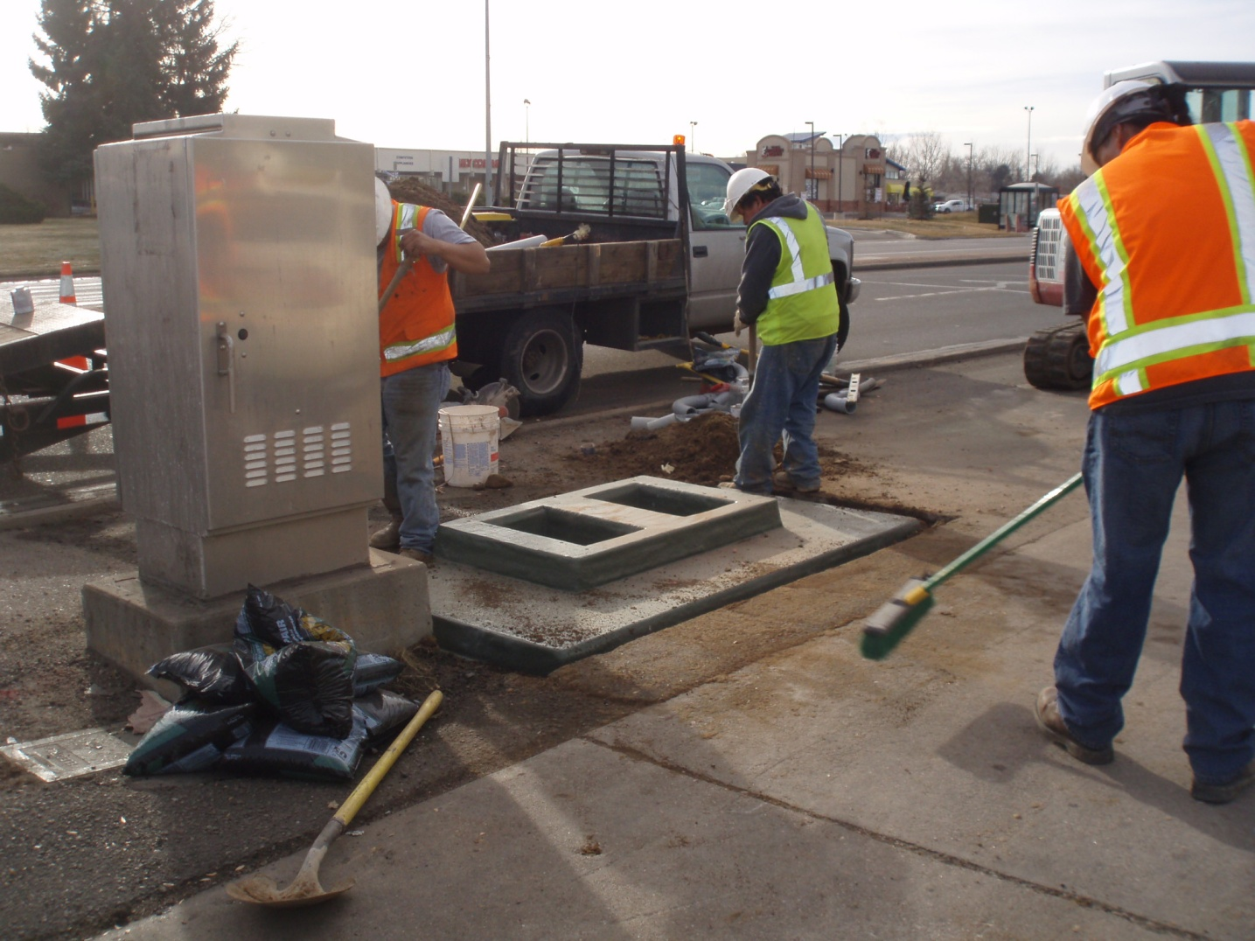
Go Back
New cabinet sizes and bases
Notes:
Cabinets needed to be resized to provide the room to install new processor

Slide 43
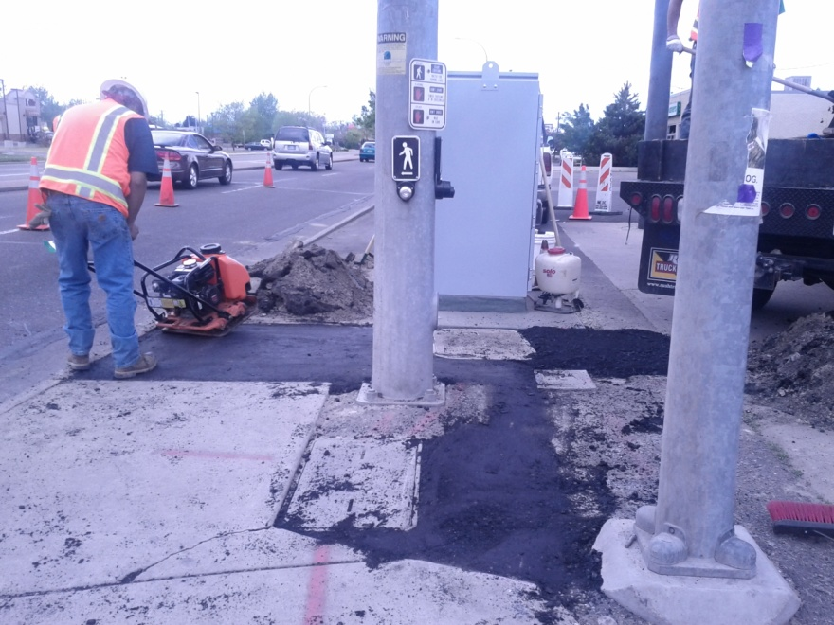
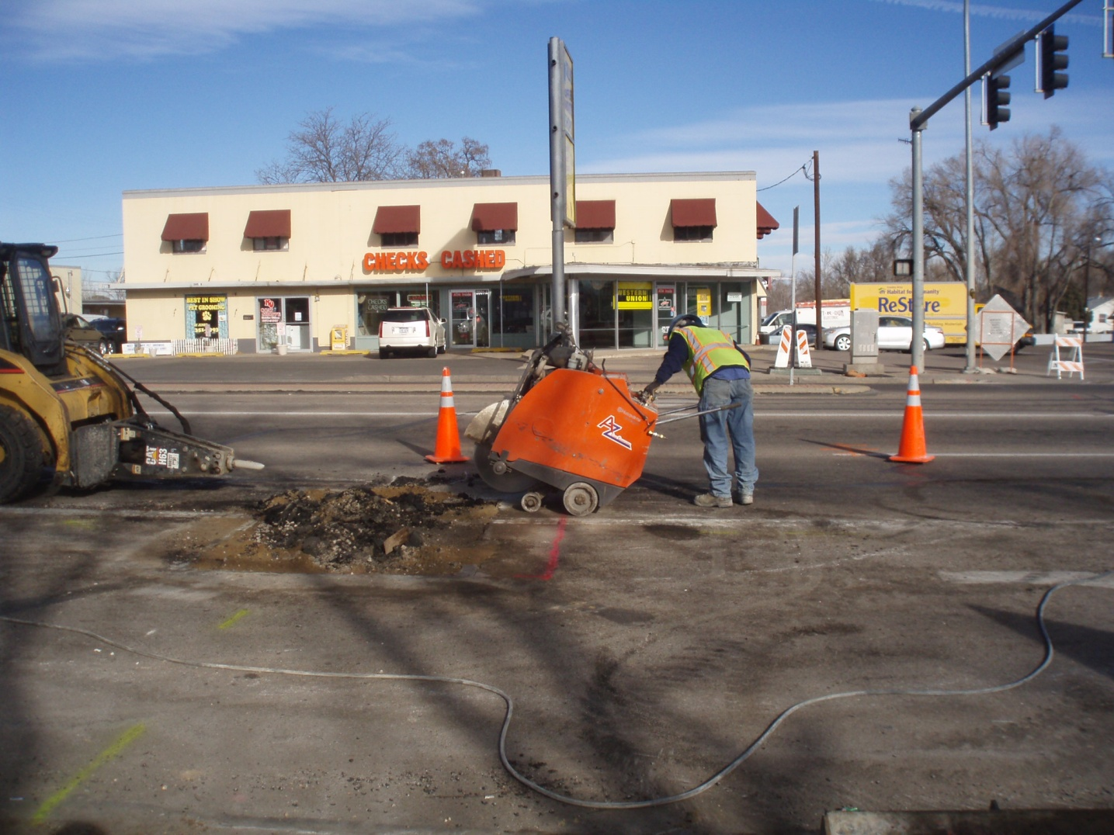
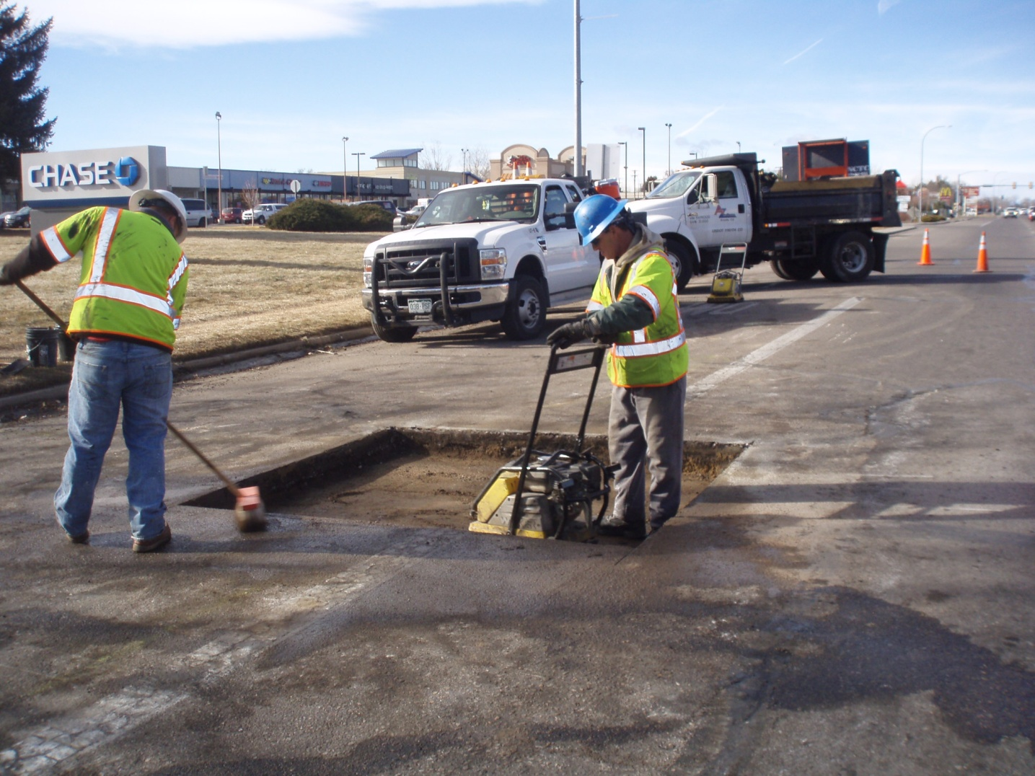
Go Back
Pavement patching
Notes:
Pavement conditions needed to be restored or patched to match existing conditions.

Slide 44
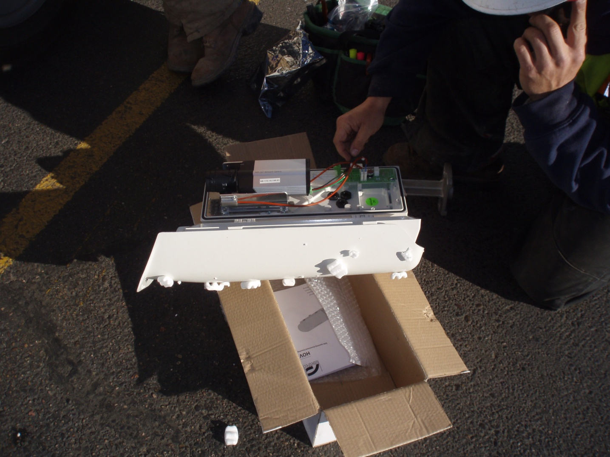
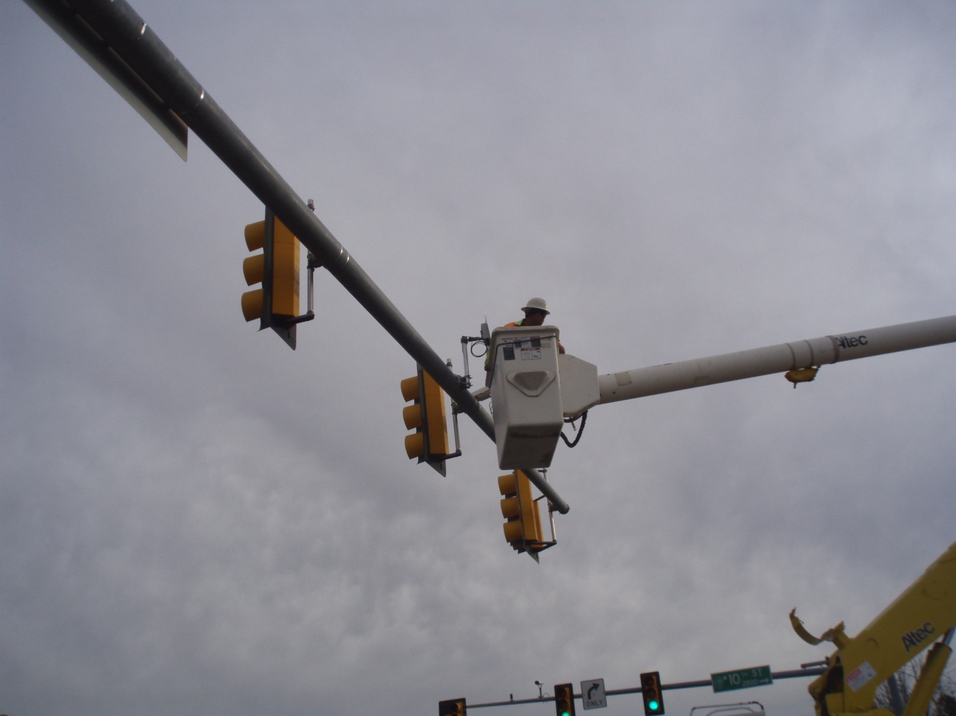
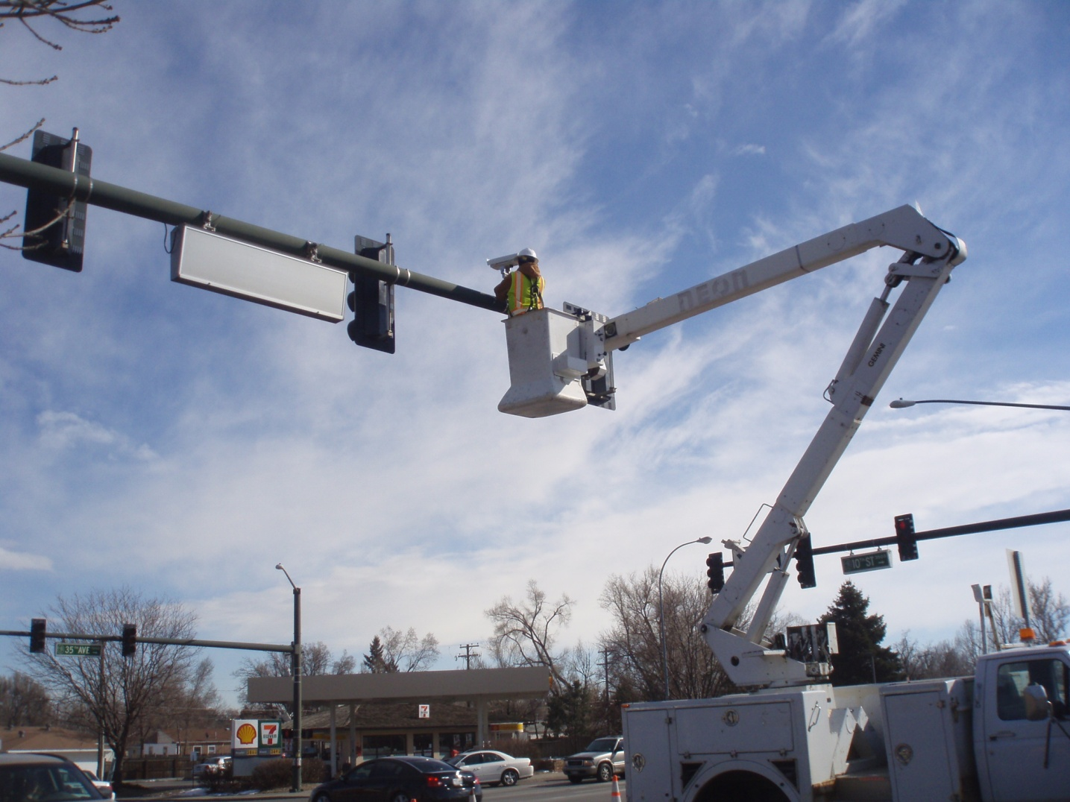
Go Back
System components
Notes:
Processor in the cabinet
Digital video cameras for detection
Radar panels for the wireless communication system

Slide 45
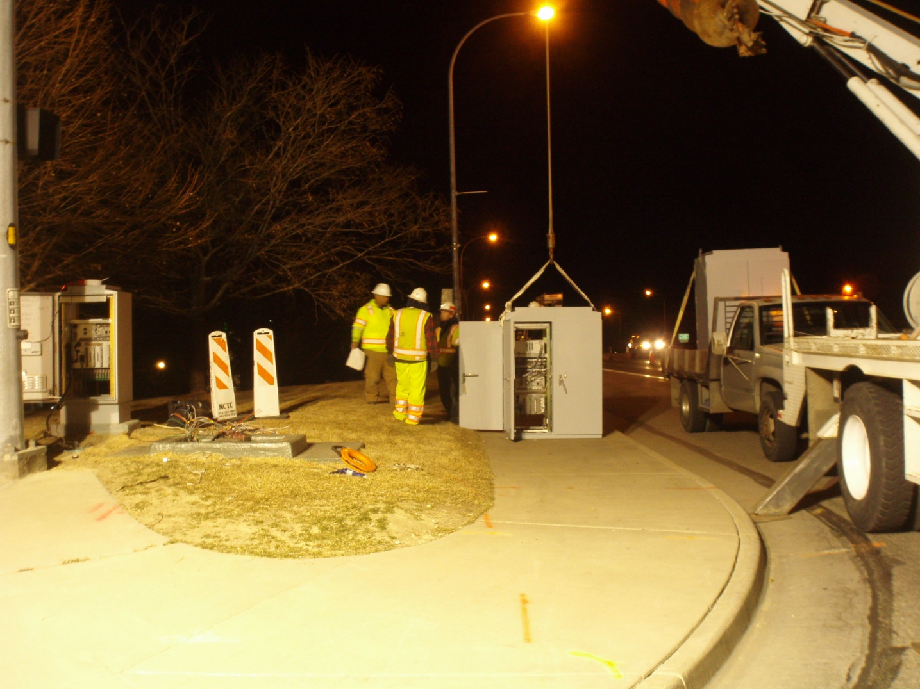
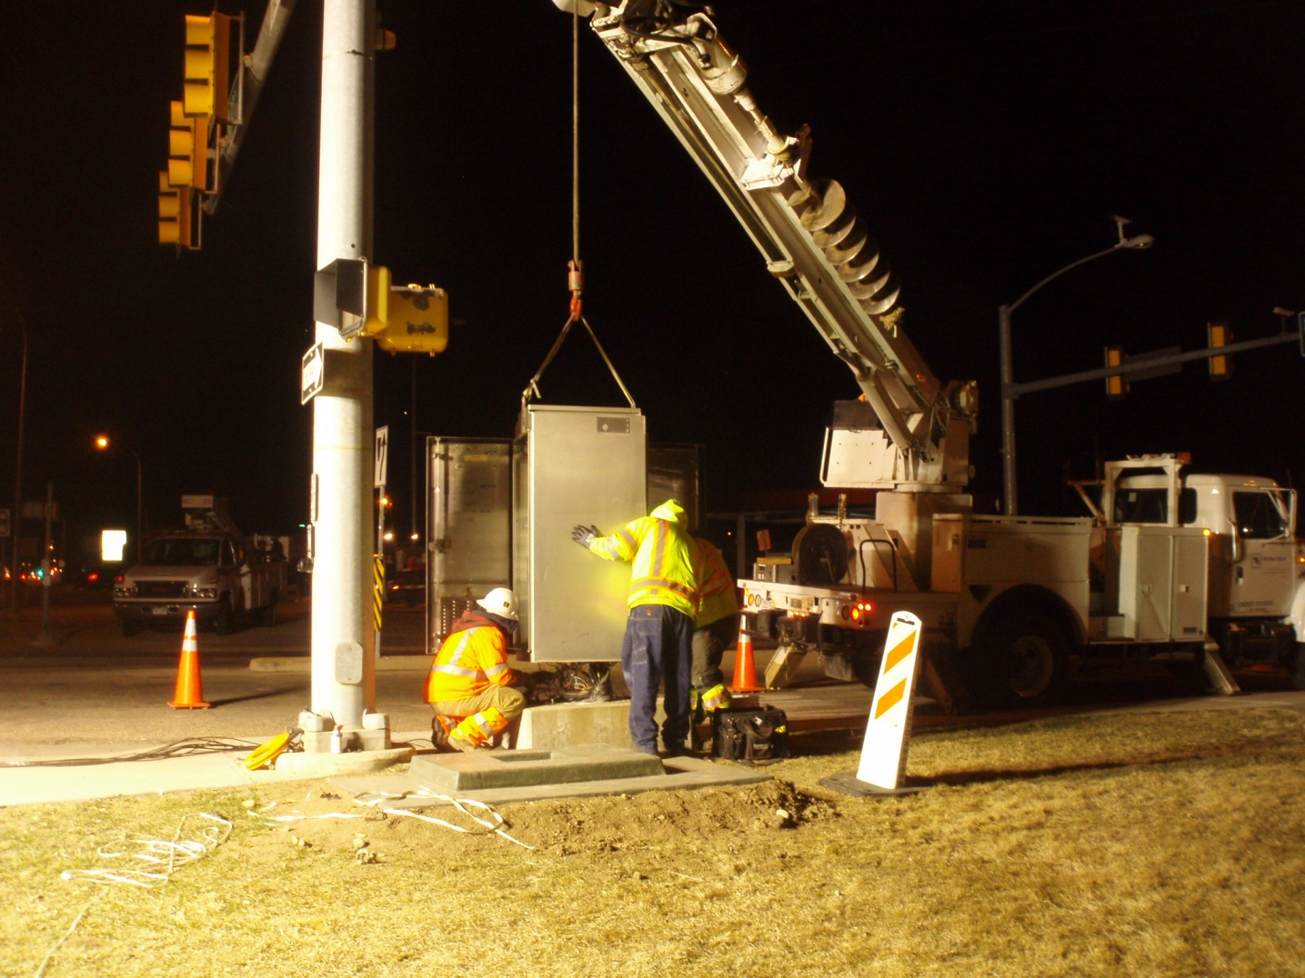
Go Back
Signal switch over at night
Notes:
Had to turn signals off during switch over to larger cabinets
Work had to be done at night to minimize impact to traveling public
Required many hours of uniformed traffic control – more cost to project

Slide 46
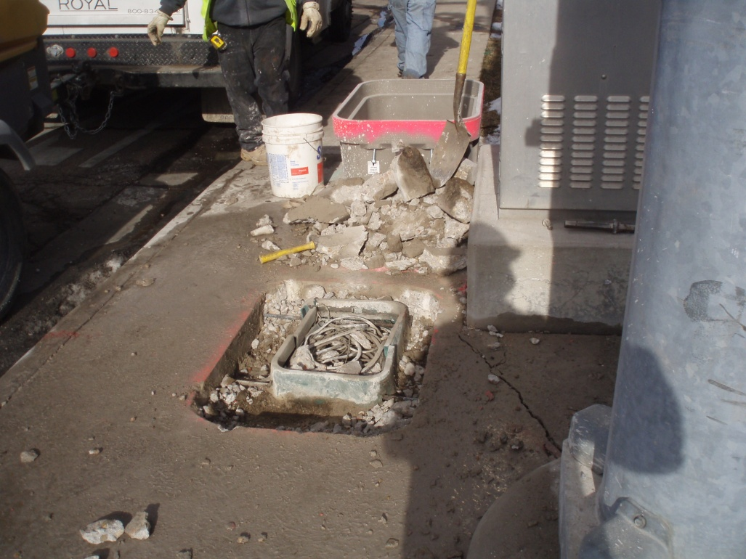
Go Back
Larger pull boxes
Notes:
Many of the pull boxes need to be up-sized to accommodate additional conduits and system needs

