Slide 1
The Month in Review
August 2011
Eric Moore
Computer Users Group of Greeley

Slide 2
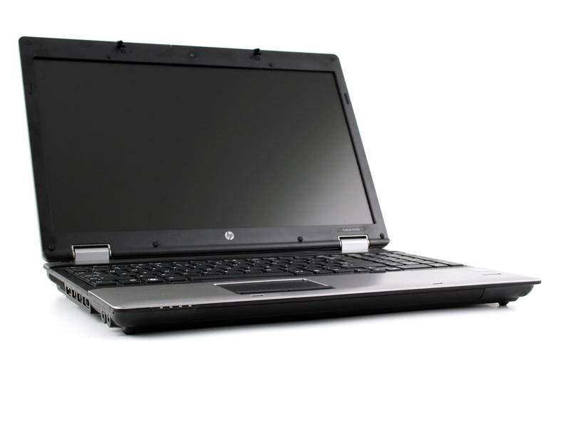
Check Out a Laptop from the High Plains Library District

Slide 3
Laptop Checkout Program
Pilot program with ten laptops was deemed a success
Expanded to eighteen brand-new laptops in Summer 2011
Requirements
  Must be 18 years old
  Valid library card in good standing
Reserve a laptop online at home or at the library
  Pick a time from the calendar
  Select the location to pick up: Farr, Centennial Park, Lincoln Park, Erie, or Carbon Valley
  Pick it up beginning Thursday
  Due back on Tuesday (five-day checkout period)
Click here for details

Slide 4
Laptop Features
HP Compaq 6555b
Windows XP Professional
Microsoft Office 2007
Internet Explorer 8.0
Wireless Internet via Verizon Wireless (wherever you can get a cell phone signal)
No cost, but must have a current library account in good standing

Slide 5
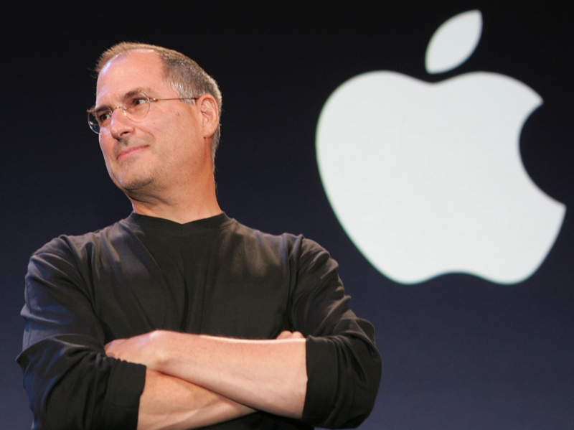
Steve Jobs Resigns

Slide 6
Apple Press Release
CUPERTINO, California—August 24, 2011—Apple’s Board of Directors today announced that Steve Jobs has resigned as Chief Executive Officer, and the Board has named Tim Cook, previously Apple’s Chief Operating Officer, as the company’s new CEO. Jobs has been elected Chairman of the Board and Cook will join the Board, effective immediately.

Slide 7
Jobs’s Letter to the Board
In a letter to the Apple Board of Directors, Jobs announced he could “no longer meet his duties and expectations as Apple’s CEO.”
He will remain on the Board of Directors.
Health issues may have played a role in his decision.

Slide 8
Steve Jobs Bio
Co-founded Apple with Steve Wozniak and Mike Markkula in 1976
In early 1980s pushed for the development of the Macintosh after seeing a computer with GUI at Xerox PARC
Resigned from the board of directors in 1985
Founded NeXT
Acquired the computer graphics division of Lucasfilm Ltd. for $5 million; spun off as Pixar Animation Studios

Slide 9
Steve Jobs Bio (cont.)
Pixar acquired by The Walt Disney company for $7.4 billion in 2006
Rejoined Apple after Apple’s 1996 buyout of NeXT
Became Apple’s CEO in 1997
In March 1998 terminate Newton, Cyberdog, and OpenDoc
NeXTSTEP evolved into Mac OS X
In early 2000s, Apple branched out into digital appliances (iPod), music distribution (iTunes), and cellular products (iPhone), and tablet computing (iPad)

Slide 10
Steve Jobs Bio (cont.)
Surgery for pancreatic cancer in July 2004
Six-month leave of absence in early 2009
Liver transplant in April 2009
Medical leave of absence in 2011
Resigned as CEO in August 2011

Slide 11
Jobs’s Legacy
Apple II
  Introduced a generation to computing and programming
Macintosh
Mac OS X
  Based on Unix operating system, facilitating its porting to the Intel platform
iPod
iTunes
iPhone
iPad

Slide 12
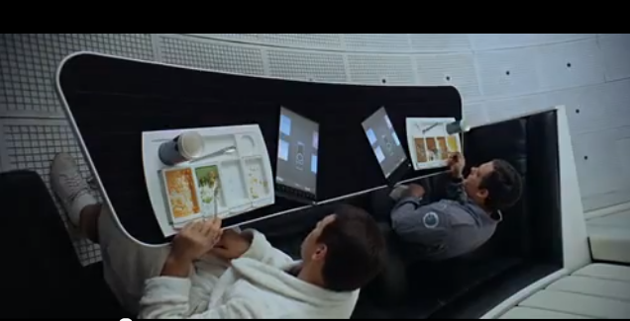
Patent Wars: Apple vs. Samsung

Slide 13
A Question of “Prior Art”
Apple filed an injunction against Samsung in early July 2011
Apple claims the design of the Samsung Galaxy Tab 10.1 allegedly infringes its intellectual property, “copying” the user interface and design features of the iPad 2
Successful injunction in European Union, but temporarily suspended
Apple seeks to ban import and sale of Galaxy smartphones and tables in the Netherlands
Samsung submitted exhibits of prior art, as proof that the overall design of the iPad 2 is not original with Apple

Slide 14
Exhibit D: Enter Hollywood
Still shot from 2001: A Space Odyssey, showing tablet computers with following features:
  Overall rectangular shape
  Dominant display screen
  Narrow borders
  Predominantly flat front surface
  Flat back surface
Source: CNET News

Slide 15

Big Changes at HP

Slide 16
Spinning Off the PC Business?
WSJ reported on August 19, 2011 that HP is exploring the possibility of spinning off its PC business
Options could include a “full or partial separation”
Abandoning efforts to cell tablets and smartphones
Would not include tech-services division, servers, networking, data-storage systems, or printers
TouchPad and smartphone haven’t sold well
PC unit is a “low-margin business”

Slide 17
Spinning Off (cont.)
CEO Leo Apotheker’s goal is to move away from consumer products and reposition HP as an enterprise business
According to a letter from Stephen DiFranco, Sr. VP and General Manager of the Personal Systems Group – Americas
  No shutdown is intended
  “HP remains committed—now more than ever—to the health and growth of its PC business”
Click here for details

Slide 18

What’s New with Google

Slide 19
Google Acquires Motorola Mobility
Announced August 15, 2011
Google and Motorola Mobility announced a definitive agreement under which Google would acquire Motorola Mobility for $40.00 per share in cash (approx. $12.5 billion)
Expected to “supercharge the Android product line and enhance competition in mobile computing”
Would better protect Google from anti-competitive threats from Microsoft, Apple, and other companies
Click here for details

Slide 20
Fall Spring-cleaning
Shutting down several products
  Aardvark social search engine
  Desktop
  Fast Flip news content browsing and reading for web and mobile devices
  Google Maps API for Flash
  Google Pack
  Google Web Security
  Image Labeler
  Notebook (data will automatically be exported to Google Docs)

Slide 21
Fall Spring-cleaning (cont.)
Sidewiki
Subscribed Links
Click here for details

Slide 22
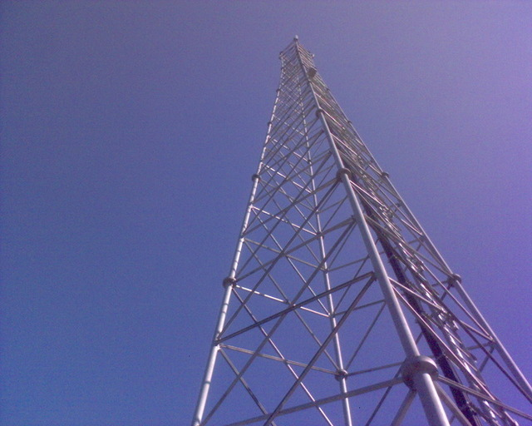
Your Online Privacy

Slide 23
Warrant Required for Cell Phone Location Data
Some courts decided when users turn on their cell phones, they are “voluntarily” transmitting their location
The Stored Communications Act only required law enforcement to show the records were “relevant and material”
Government had asked Verizon Wireless to turn over 113 days of location data about a suspect’s phone
Judge Nicholas Garaufis of the Eastern District of New York soundly rejected this line of reasoning
Click here for full story

