Slide 1
Text Messaging
CUGG Computer User’s Group of Greeley
July 14, 2012
Stan Sameshima

Slide 2
Your phone constantly “checks in”

Slide 3
Sending a text
SMS (short message service) is limited to 160 characters

Slide 4
Sending a text
SMS (short message service) is limited to 160 characters
Can be sent to phones, computers, and PDAs

Slide 5
Sending a text
SMS (short message service) is limited to 160 characters
Can be sent to phones, computers, and PDAs
PDA = Personal Digital Assistant

Slide 6
Your SMS text goes to a SMSC (short message service center) to be delivered or held for several days

Slide 7
EMS Enhanced Messaging Service
Formatted text
Sound effects
Small pictures and icons

Slide 8
MMS Multimedia Messaging Service
Animations
Audio and video files
Streaming video
Requires a 3G network

Slide 9
So What?
unobtrusive, private, no one can overhear

Slide 10
So What?
unobtrusive, private, no one can overhear
multitasking, available in all environments

Slide 11
So What?
unobtrusive, private, no one can overhear
multitasking, available in all environments
Could be faster for a short message

Slide 12
So What?
unobtrusive, private, no one can overhear
multitasking, available in all environments
Could be faster for a short message
May be sent to multiple recipients

Slide 13
So What?
unobtrusive, private, no one can overhear
multitasking, available in all environments
Could be faster for a short message
May be sent to multiple recipients
Doesn’t have to be answered immediately

Slide 14
So What?
unobtrusive, private, no one can overhear
multitasking, available in all environments
Could be faster for a short message
May be sent to multiple recipients
Doesn’t have to be answered immediately
You can review what you are sending before you send it

Slide 15
So What?
unobtrusive, private, no one can overhear
multitasking, available in all environments
Could be faster for a short message
May be sent to multiple recipients
Doesn’t have to be answered immediately
You can review what you are sending before you send it
For deaf or hearing-impaired

Slide 16
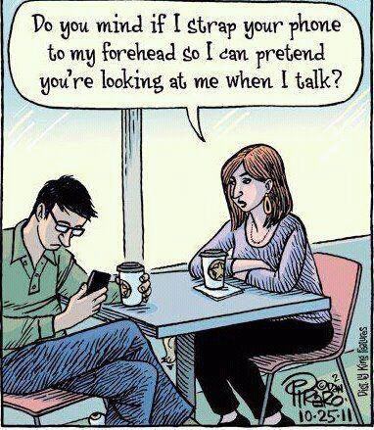
About Multitasking

Slide 17
And besides that
Text and a video
Text and a link
Text and a picture
Text me your name!

Slide 18
Furthermore
weather alerts, news headlines
medication reminders
movie showtimes or local business listings from Yahoo! or Google after texting a query
Television poll or other poll won’t overload a network or require voice operators
networking services such as Dodgeball use SMS to alert people when their friends or crushes are nearby

Slide 19
However
Texting costs money
Texting became possible in the U.S. and Canada when companies figured out how to charge for texts from other companies
A text message cost a company one third of one cent to send
Charging 10 to 20 cents is a markup of… 4,000% ?

Slide 20
Free apps are available
Apps were invented that used data networks to send texts for free
About ¼ of texters use a free app
Free apps are apparently legal
Users may have to see advertisements or pay a fee
Search for free texting apps to find one appropriate for you

Slide 21
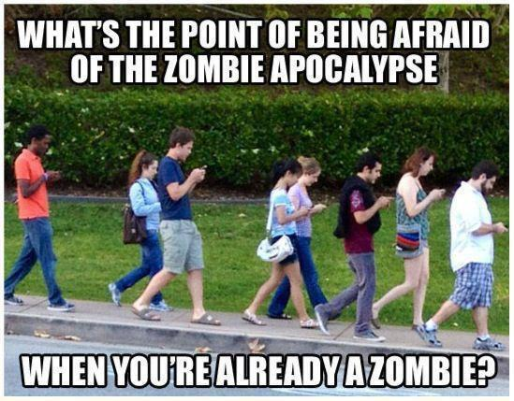

Slide 22
Texting often done in “shortcuts”
Some shortcuts are acronyms: LOL, LOLZ, OMG or AMG or OMD
Some shortcuts are compressed words or inventive phonetic spelling: sup, plz, l8r
Some are new words: meh (means mediocre), props (proper respect or acknowledgement)

Slide 23
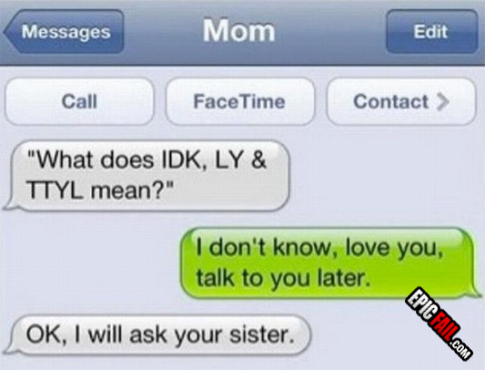

Slide 24
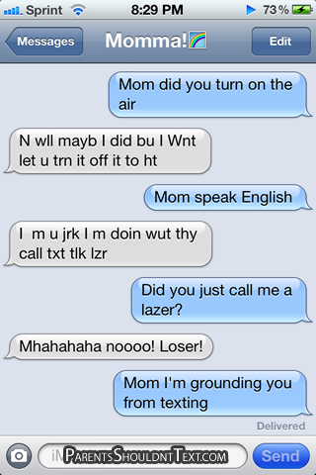

Slide 25
Online word lists
Some common shortcuts: http://netforbeginners.about.com/od/internetglossary/tp/The-Top-Text-Message-Acronyms-of-2011.htm
A dictionary of shortcuts: http://www.webopedia.com/quick_ref/textmessageabbreviations.asp/

Slide 26
Messaging can be done using the data network on a smartphone
Email, Windows Messenger, Yahoo!, AOL instant messaging (AIM), ICQ, facebook messages, VoIP, Skype, Google+
facebook, twitter, tumblr, and blogs are all free and are meant to be viewed by groups or made public

Slide 27
There are many programs that allow you to send text messages from your computer to phones
MSM messages can be sent via email: http://www.ehow.com/how_2160755_send-text-message-cell-phone.html
Verizon phones can be messaged from a computer by going to a Verizon website or emailing Verizon: http://www.ehow.com/how_2279421_send-verizon-wireless-customer-computer.html
AT&T is developing something called “Encore,” which will allow you access messages on iPhone, iPad, and computers http://www.att.com/gen/press-room?pid=21023
Sprint offers a service that will send messages from your computer to the MSM Center to any phone http://www.sprintusers.com/textmessage/

Slide 28
Google Play has an app that syncs your phone and your computer, but only works with Android phones http://mightytext.net/ https://play.google.com/store/apps/details?id=com.verizon.messaging.vzmsgs&hl=en
iPhone users have iMessage for other Apple devices: http://www.apple.com/ios/features.html
Happy Fingers app for iPhone for PCs: http://www.happyfingersapp.com/
video of “WifiSMS” is harder to set up, but is more integrated: http://www.youtube.com/watch?v=CRUy-1t7KEw

